Slide 1



CITY
Home Electronics
Group Code
NXT19_CAI2_ERP4_S2
Instructor
Eng. Mohamed Tarek
Prepared by
Mohammed Ismail
21088287
Fady Michael
21087225
Shehab Mohamed
21087225

Slide 2
Track: Oracle Digital Accounting Specialist
Group Code:NXT19_CAI2_ERP4_S2
Instructor: Mohamed Tarek

Slide 3
Team Members
Mohammed Ismail Nasrallah Abdelrahman.
21088287
Creating Chart of Accounts
Creating Calendar
Creating Currency
Fady Michael Hezkial Abdallah.
21087225
Creating Ledger Sets
Open Periods
Journal Entries
Reverse Entry
Shehab Mohamed Mohamed Omara.
21087225
Intra Company
Budgeting
Reports
FSG

Slide 4
Project Title
Implementation of Oracle General Ledger in the ERP Server for Enhanced Financial Operations in (City) (Home Electronics).

Slide 5
Project Introduction
Before the digital transformation, City Home faced numerous challenges in managing its financial operations, relying on traditional methods such as paper records and Excel spreadsheets. This led to delays in processes, an increased likelihood of human errors, and difficulty in generating accurate reports in a timely manner, negatively impacting financial efficiency and decision-making speed.
With the implementation of the Oracle ERP system, specifically the Oracle General Ledger module, the company transitioned to a fully integrated digital environment. Financial operations are now recorded with precision and speed, enabling automatic and real-time reporting, strengthening internal controls, and reducing costs. This has significantly improved financial performance and enhanced decision-making, based on reliable and up-to-date data.

Slide 6
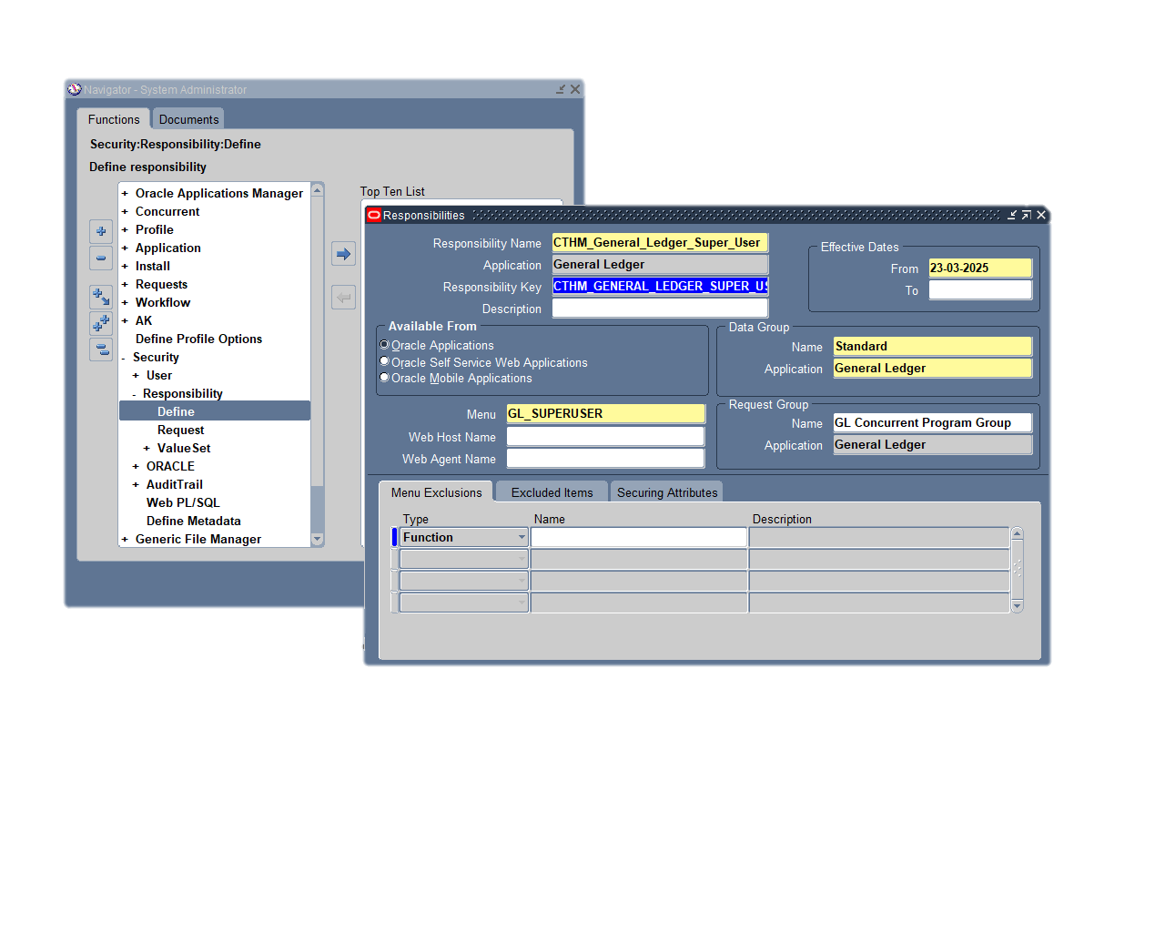
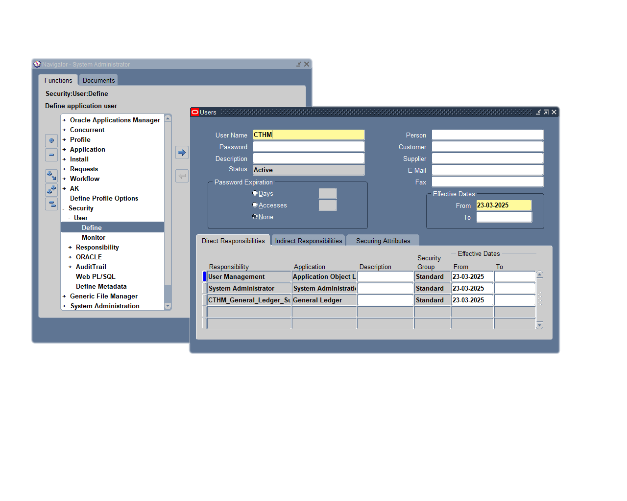
Preliminary Step: Creating a User and Assigning Responsibilities
Responsibilities
Users

Slide 7
SETUP: 4Cs
1.
3.
Creating Chart of Accounts
Creating Currency
4.
Accounting Setup
2.
Creating Calendar

Slide 8
1.Creating Chart of Accounts

Slide 9
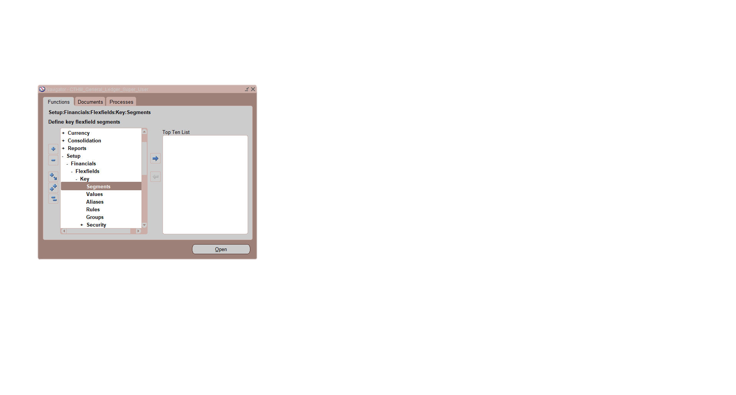
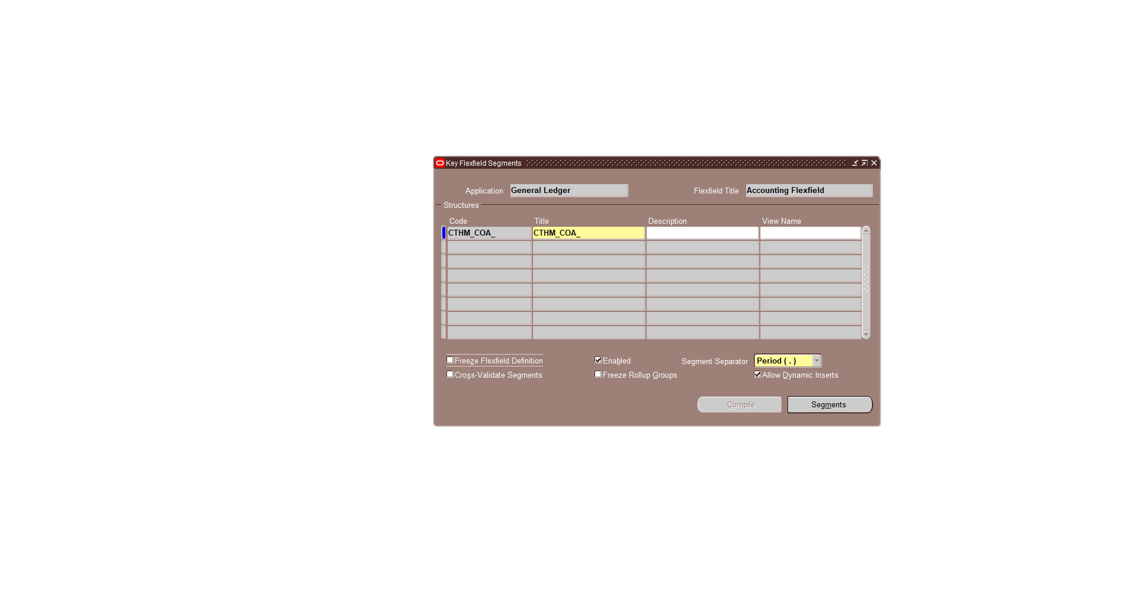
A: Key Flexfield Segments
N: Setup → Financials → Flexfields → Key → Segments
Use these windows to define the key Flexfield structure:
1
Query Application as General Ledger and Flexfield Title as Accounting Flexfield.
1
2
2
Enter the new structure Code & Name.
3
Enable Allow Dynamic Inserts.
3
4
Segments button.
4

Slide 10
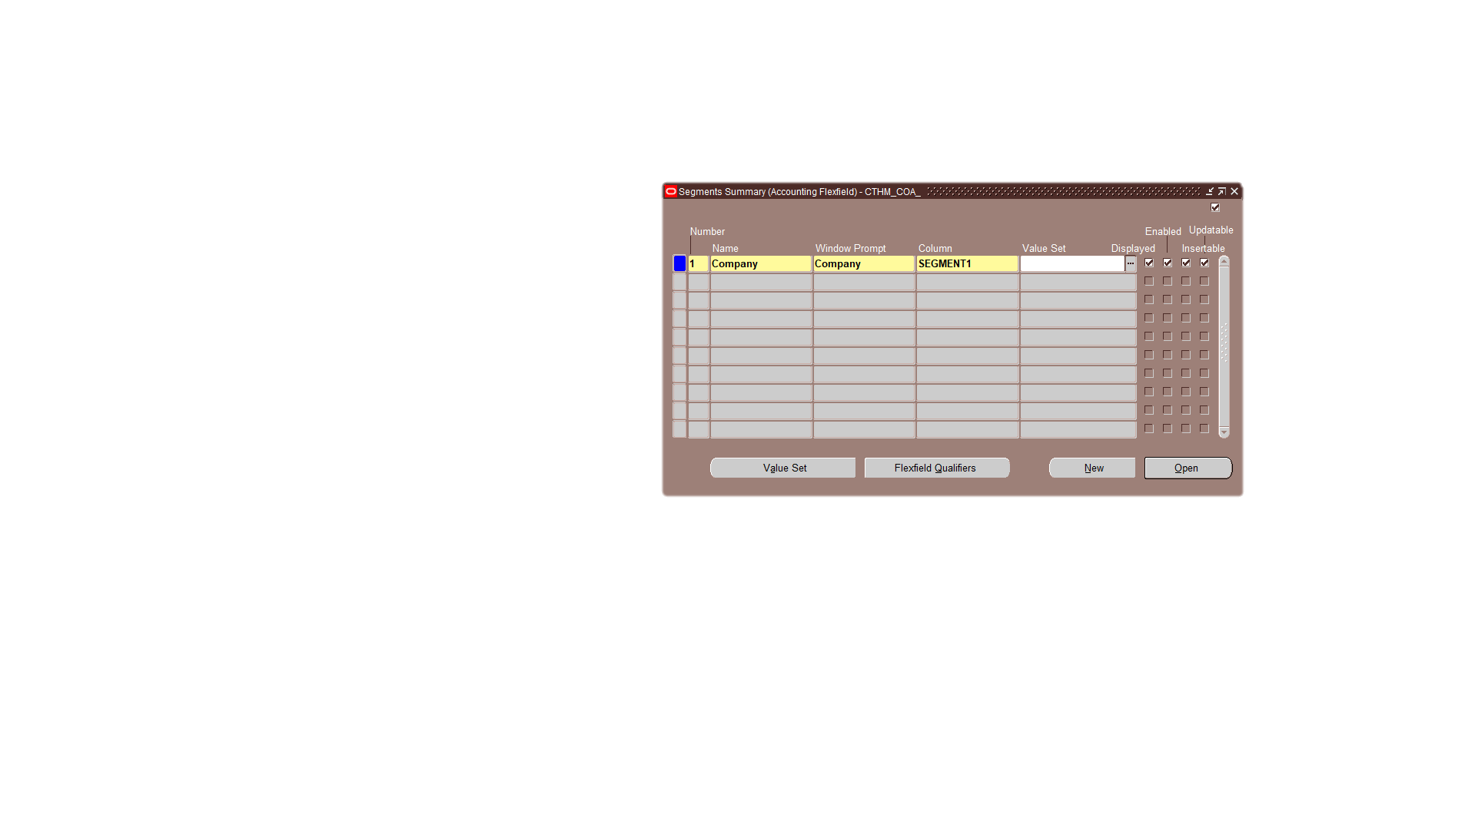
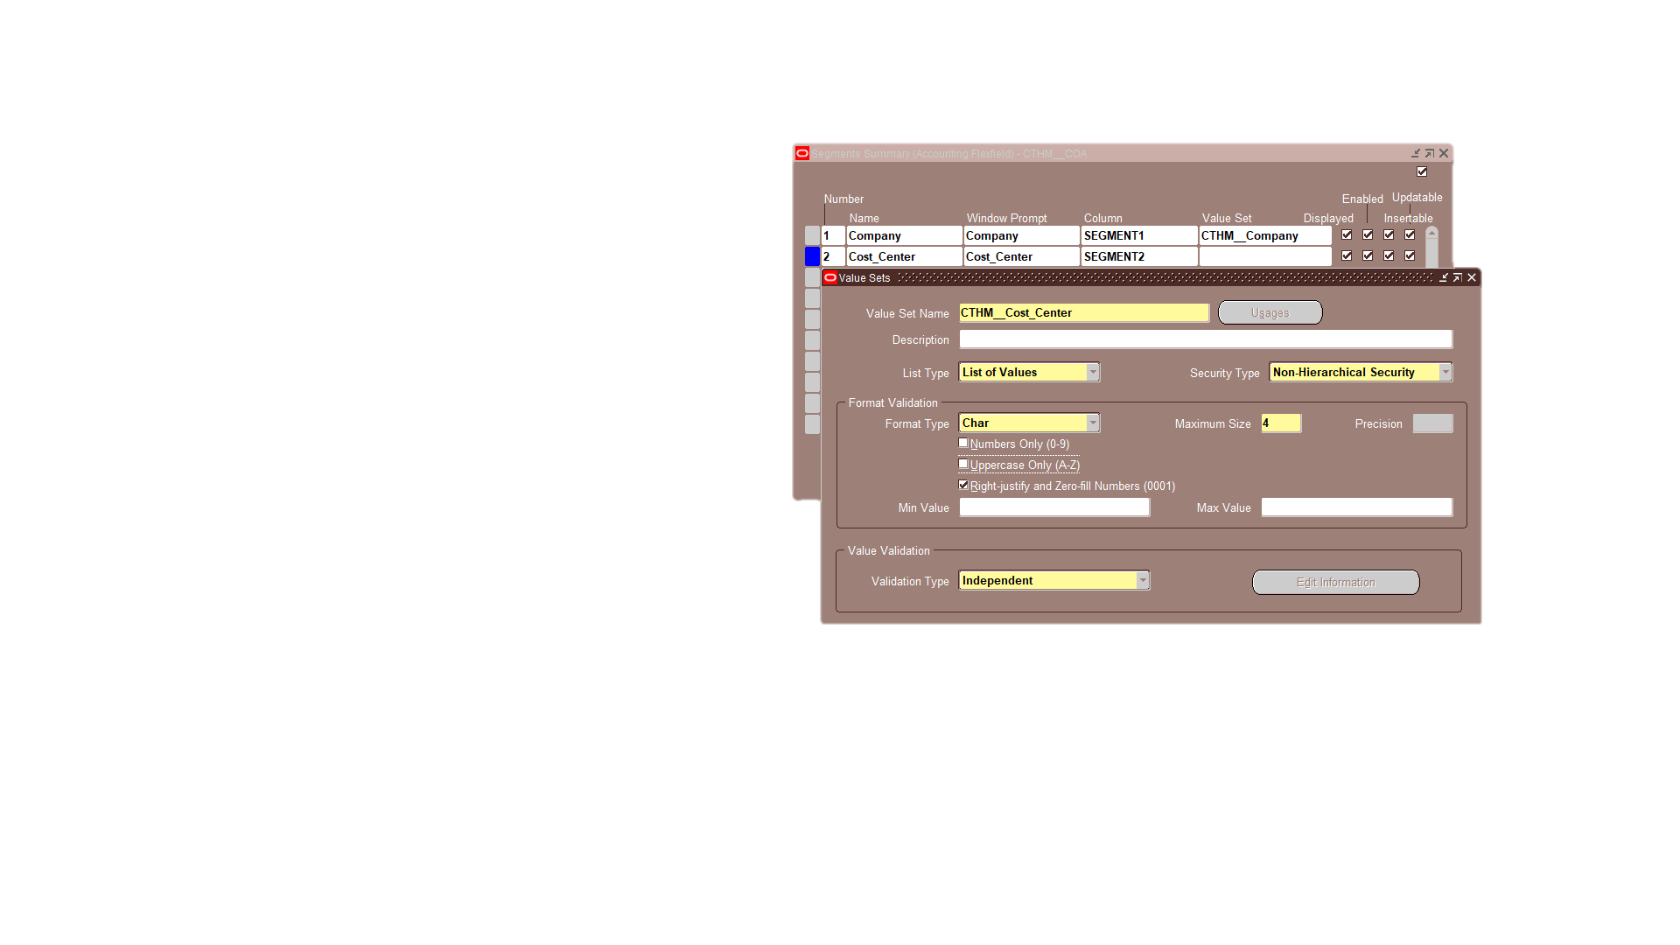
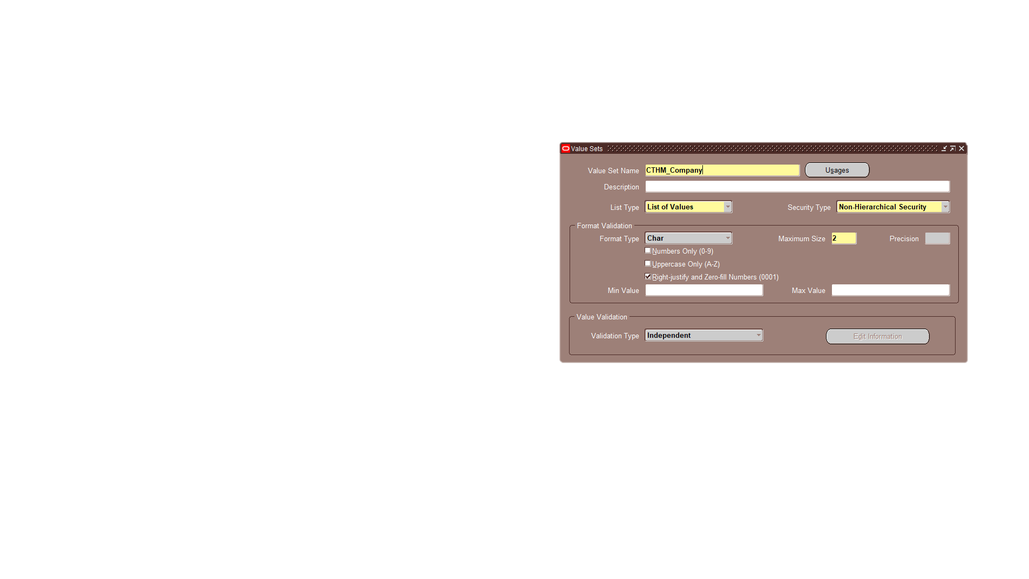
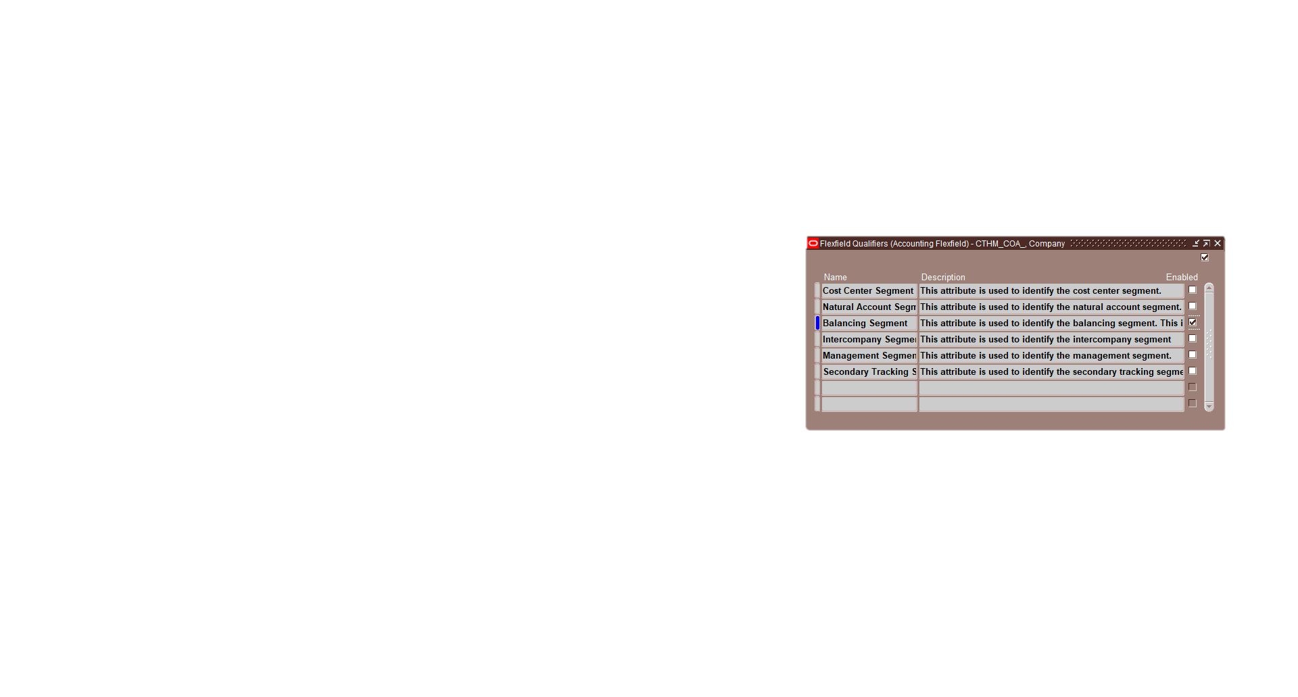
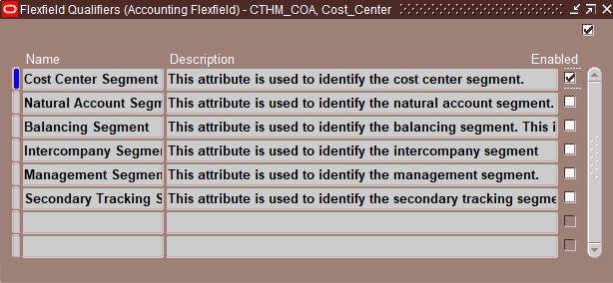
Company
Cost Center
Value Set
Flexfield Qualifiers

Slide 11
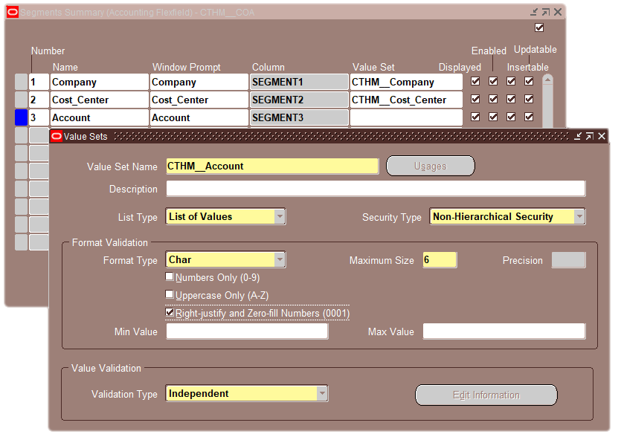
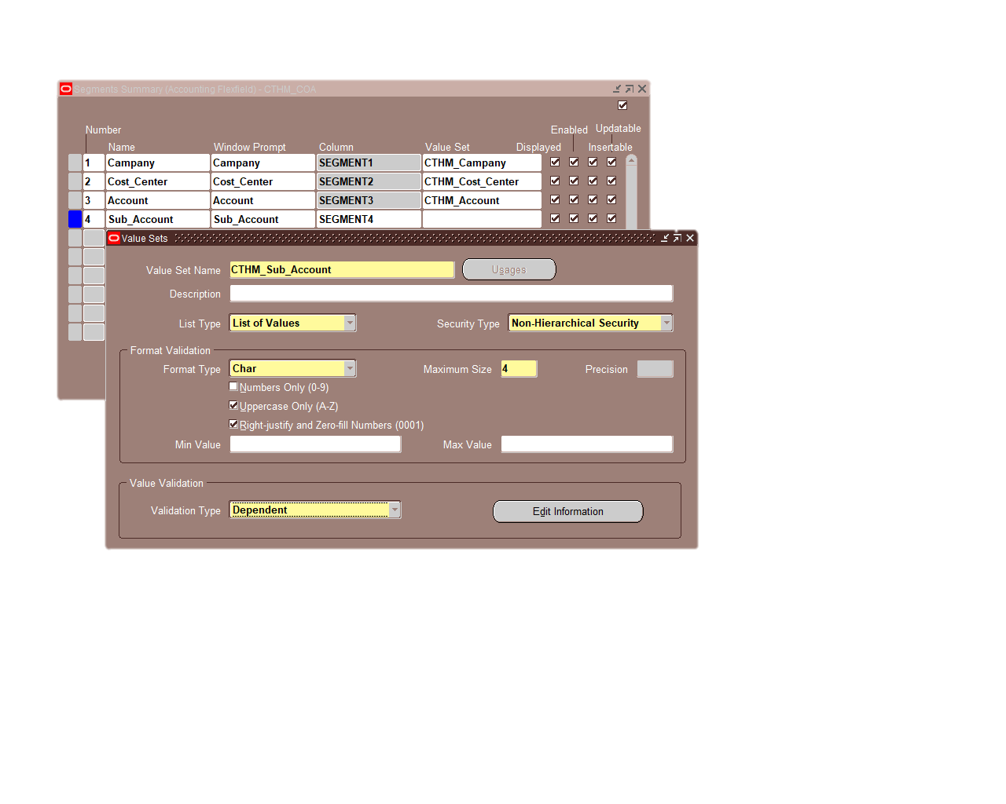
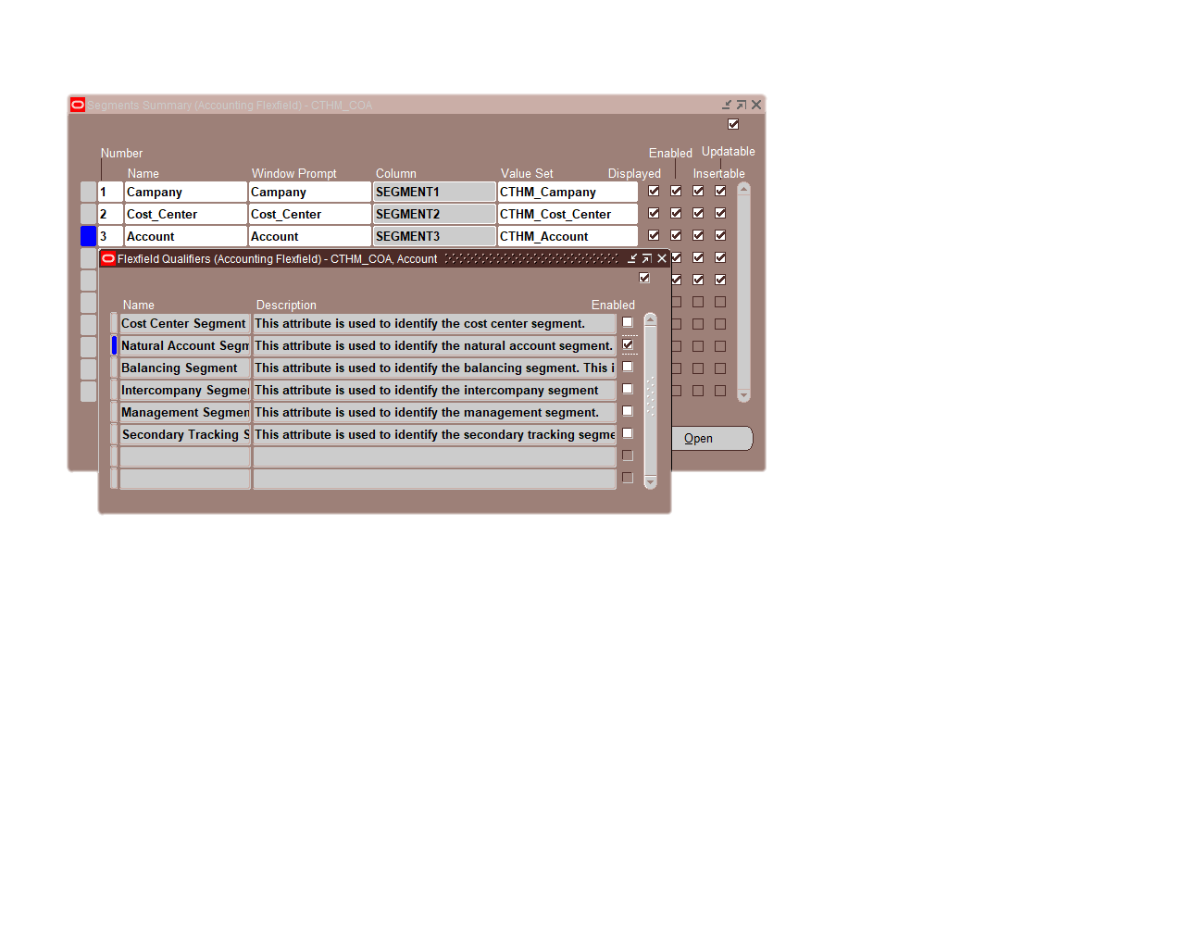
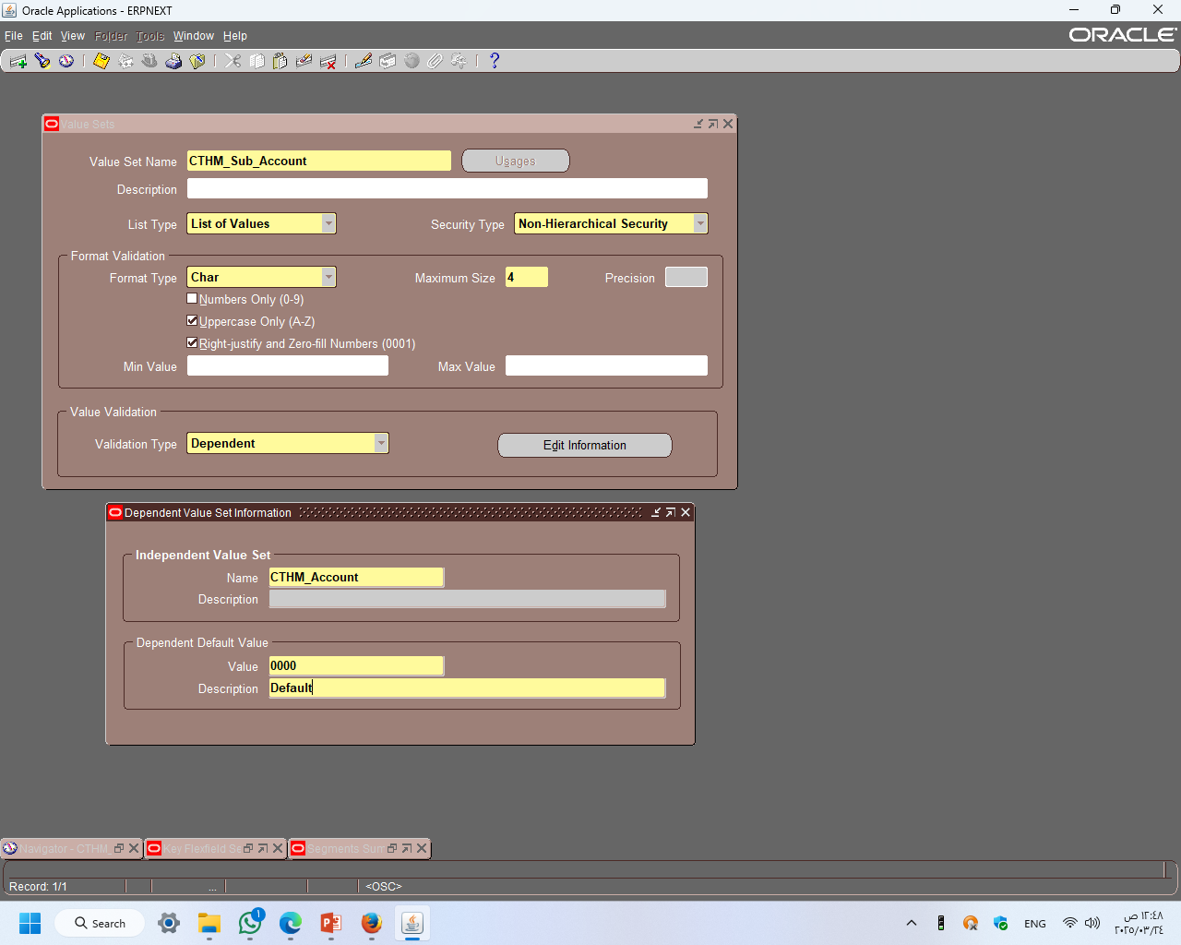
Account
Sub Account
Value Set

Slide 12
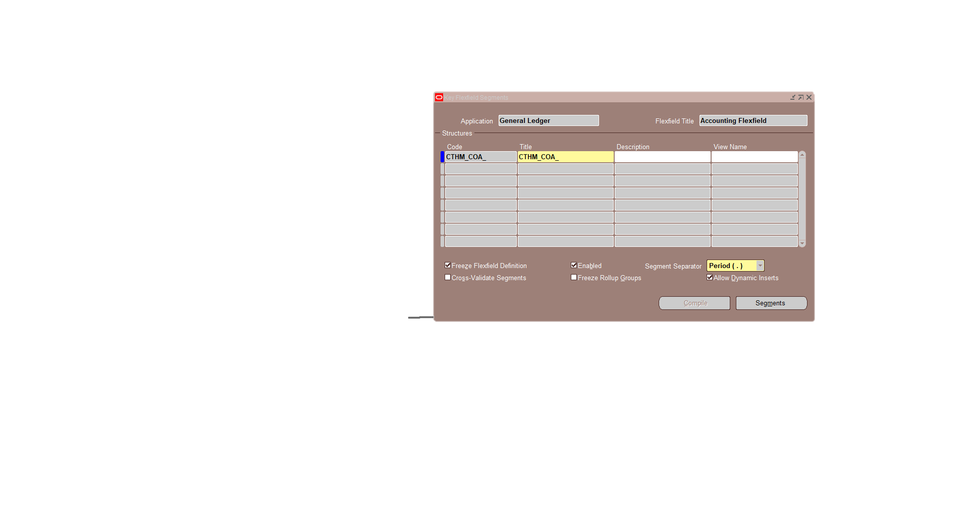
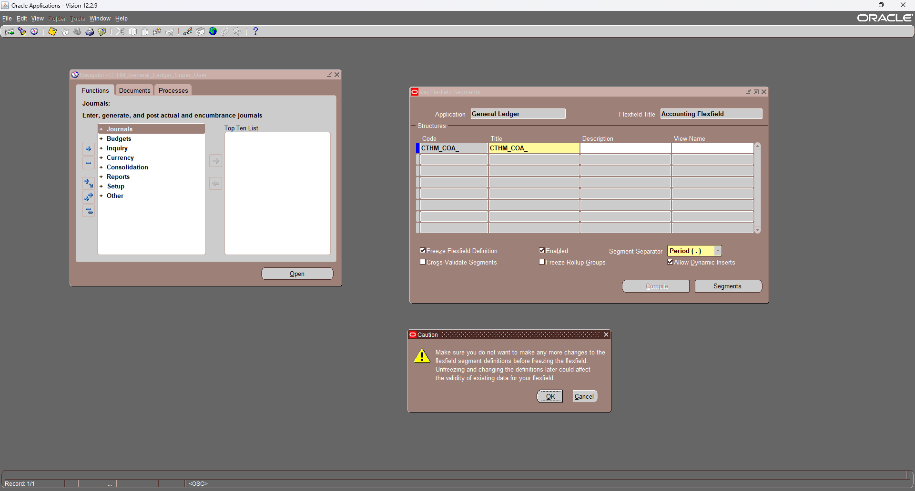
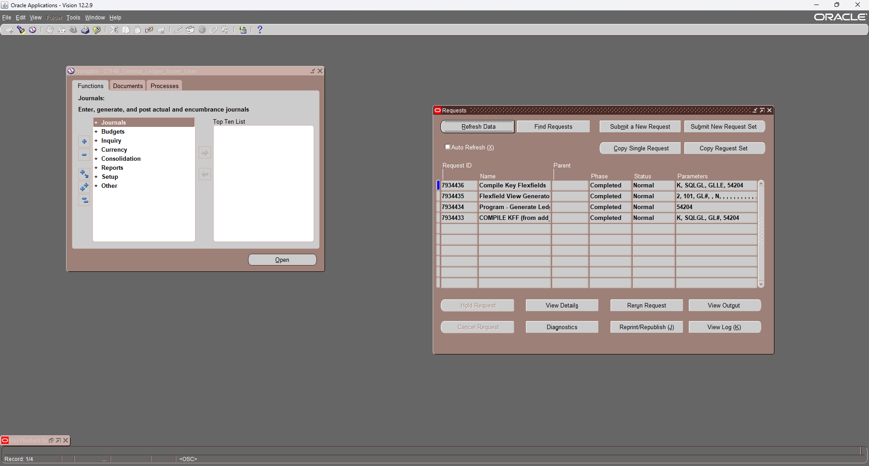
Save & Compile
1
Select Freeze Flexfield Definition
2
Click Compile
3
3
Click ok
1
2
Go to the Reports screen to verify that the processes have been completed successfully

Slide 13
Defining Segment Values

Slide 14
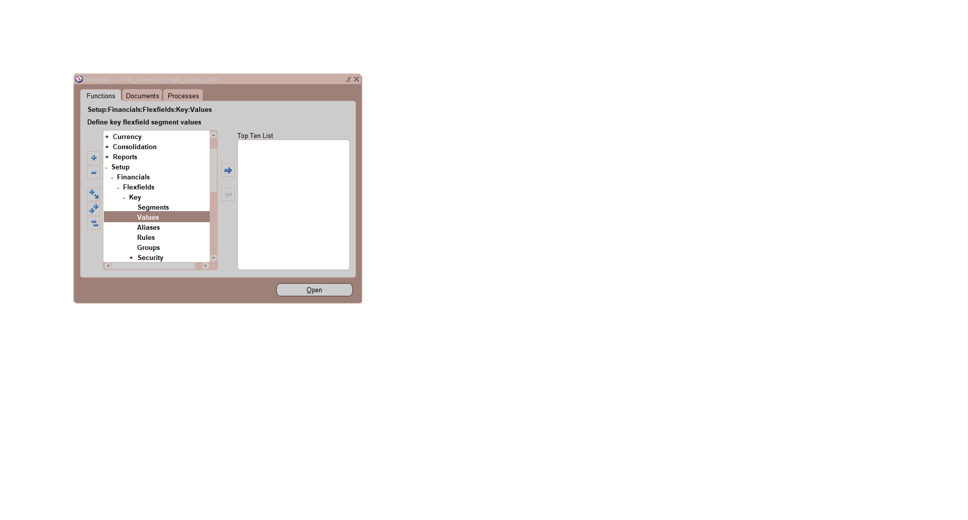
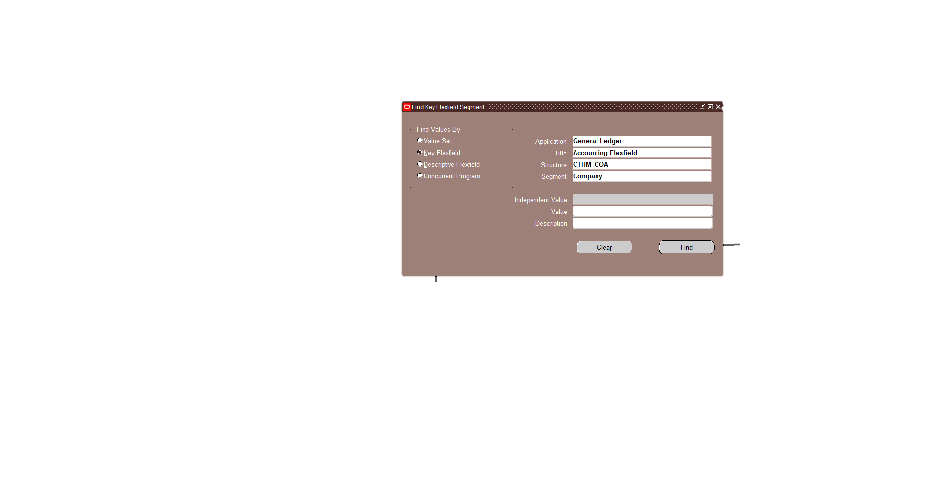
B: Segment Values
N: Setup → Financials→ Flexfields → key → Values
1
Enter:
Application: General Ledger
Title: Accounting Flexfield
Structure: CTHM_COA
Select Segment: Company
1
2
2
Click on Find

Slide 15
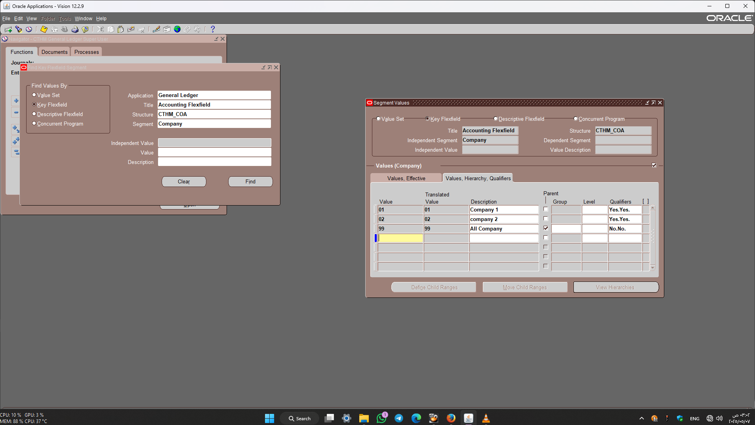
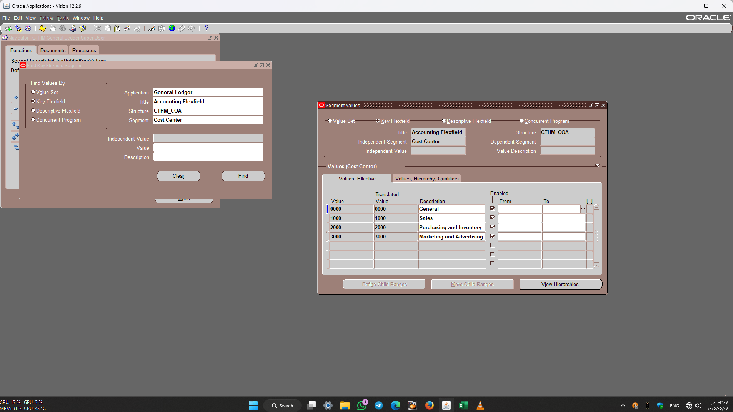
Company
Cost Center

Slide 16
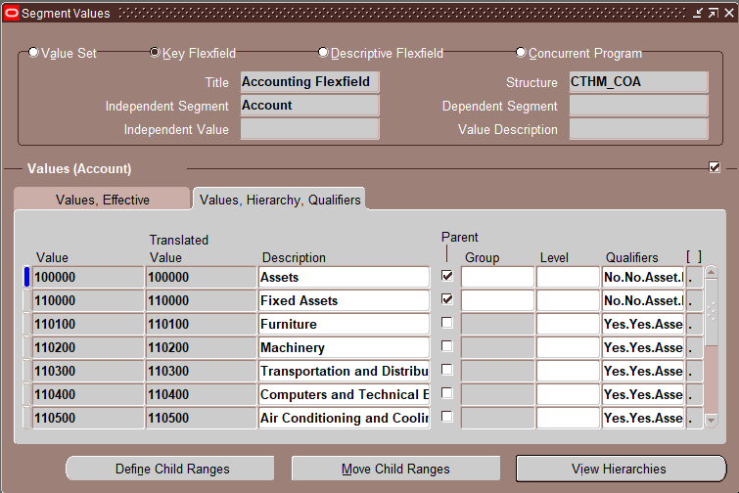
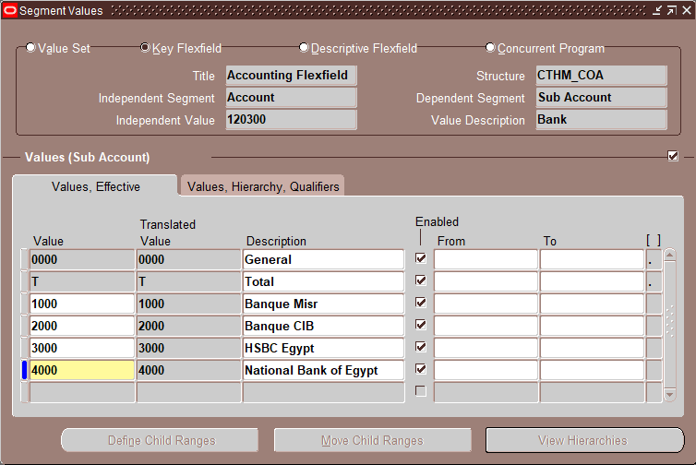
Account
Sub Account
Enter the range of values to be included as children under the parent account.
Select the Account you will create a sub-account on.

Slide 17
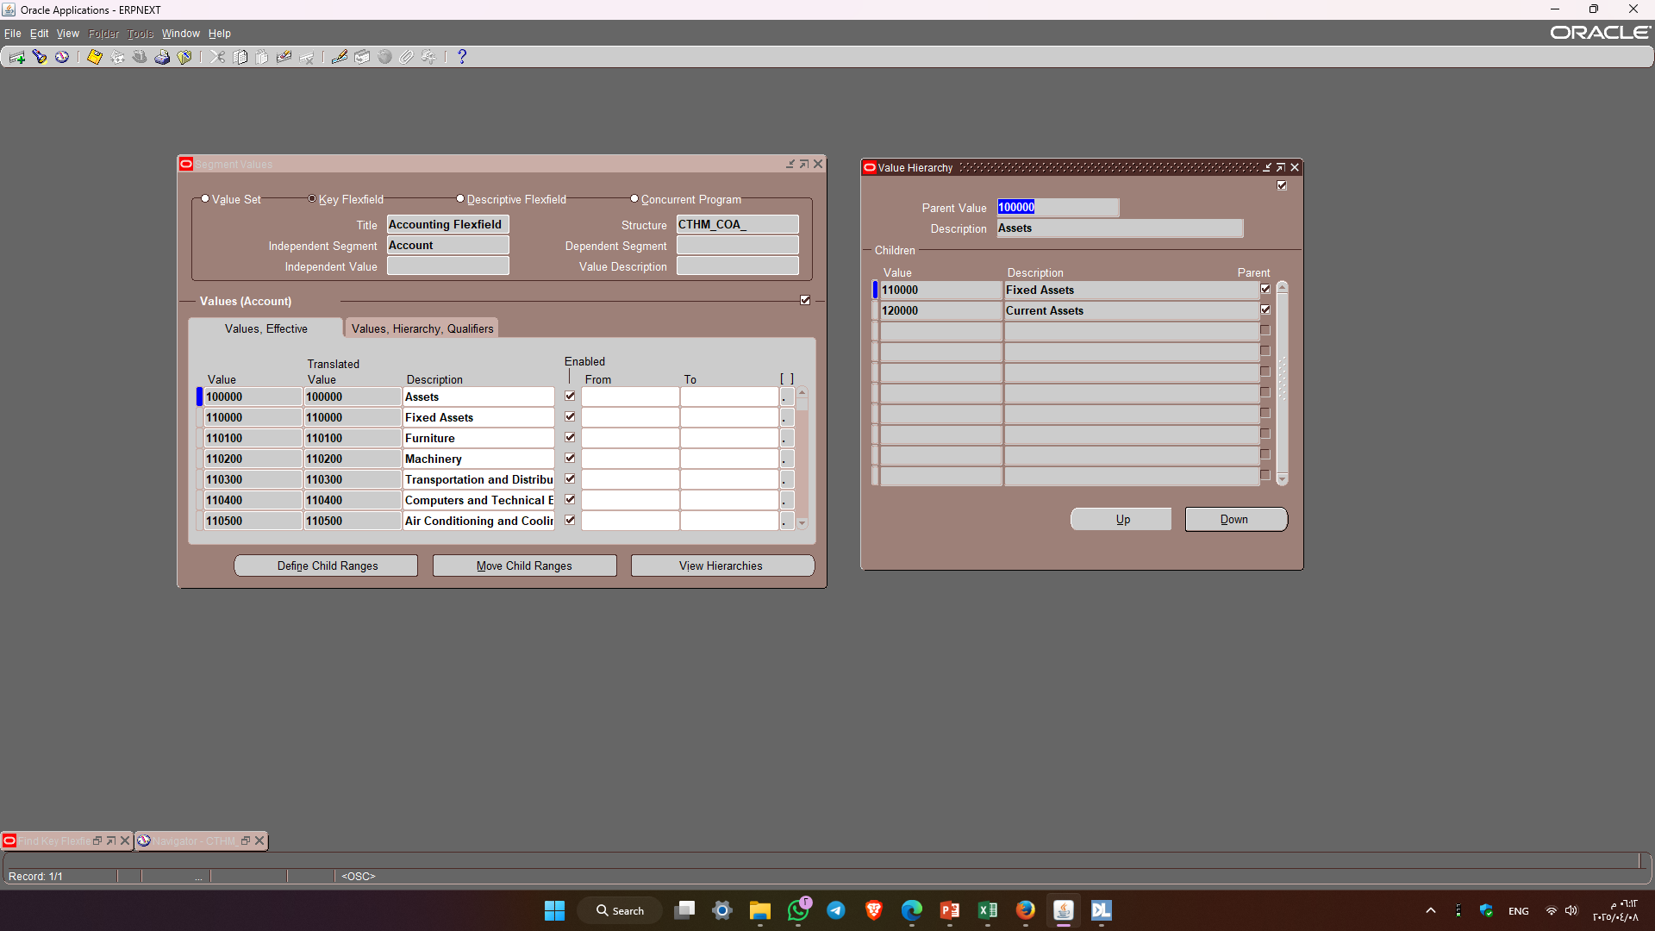
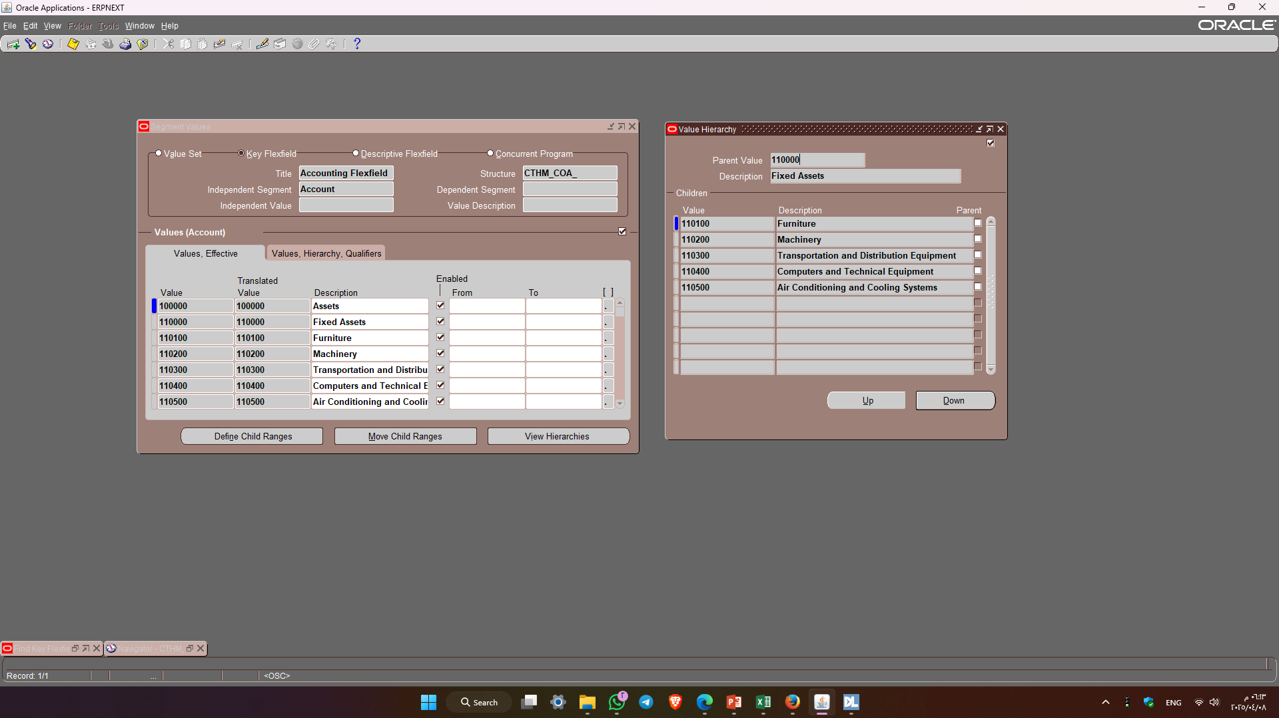
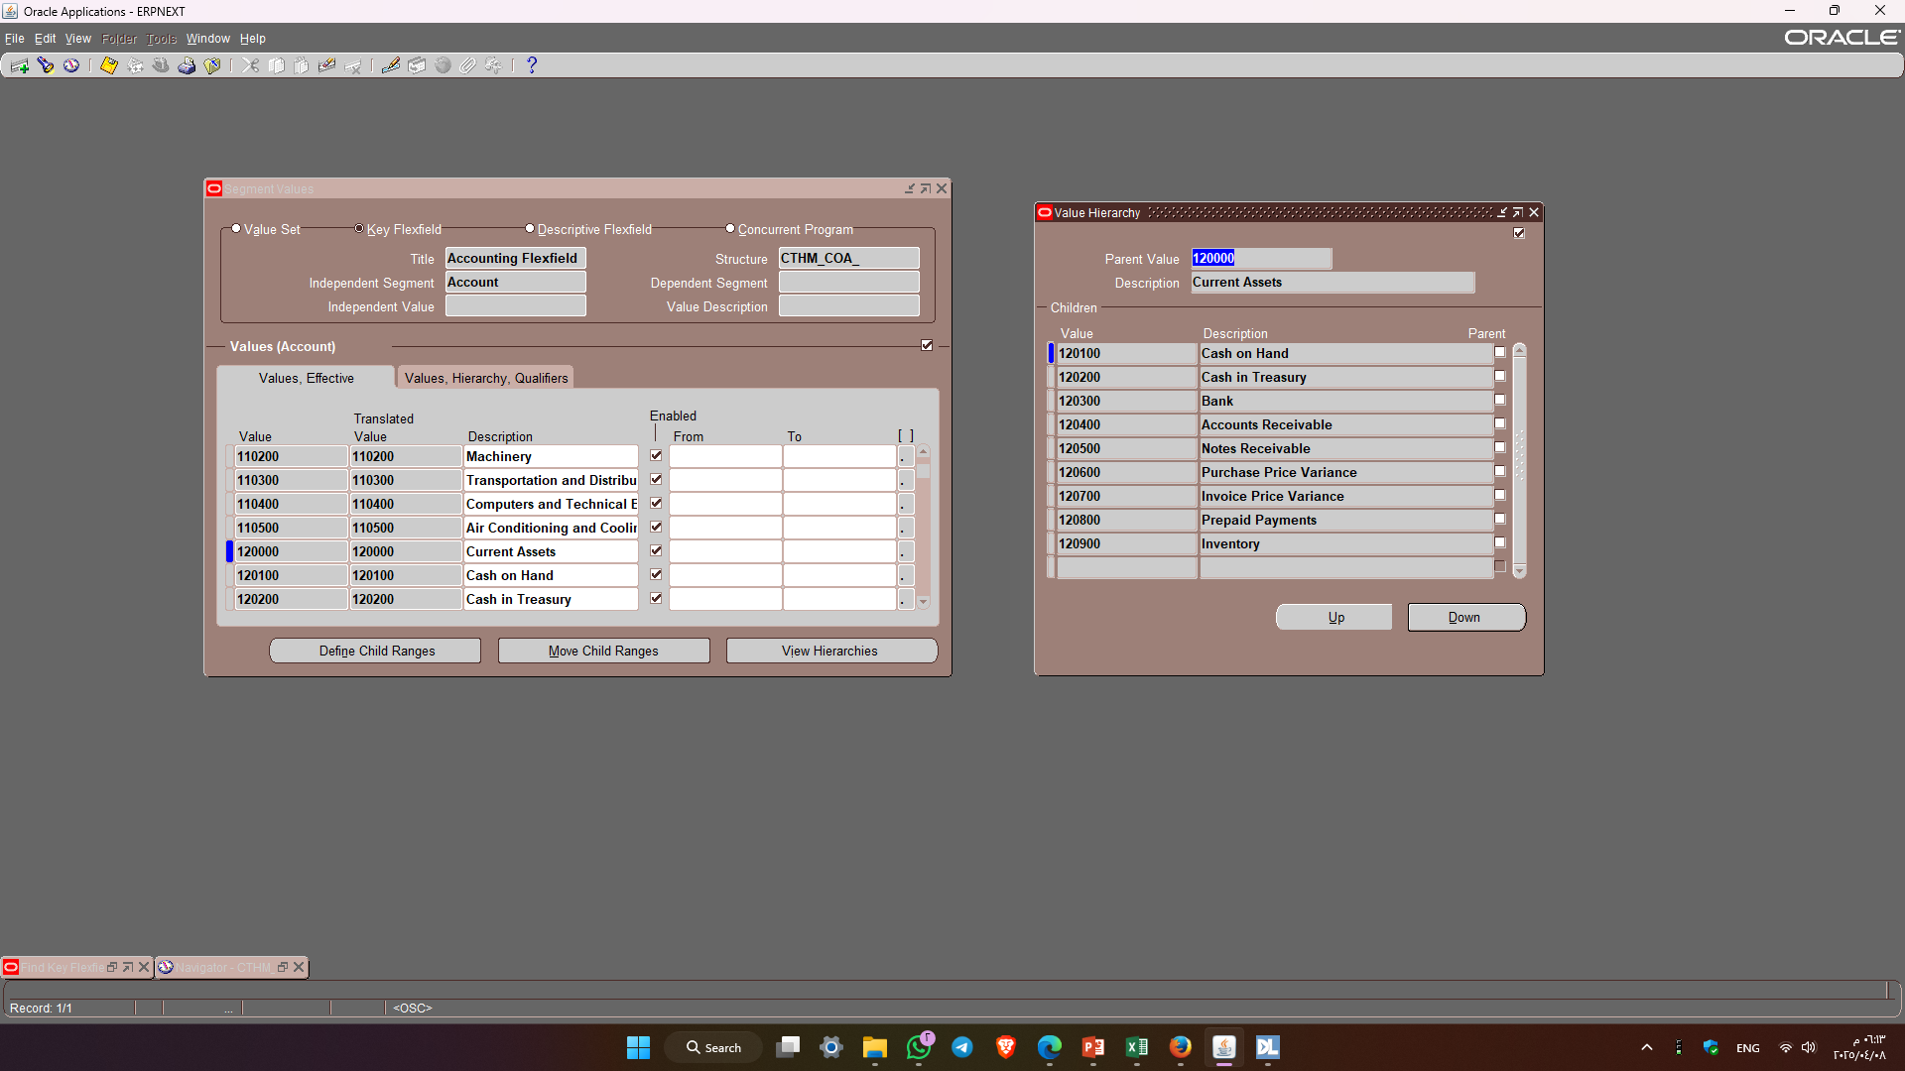
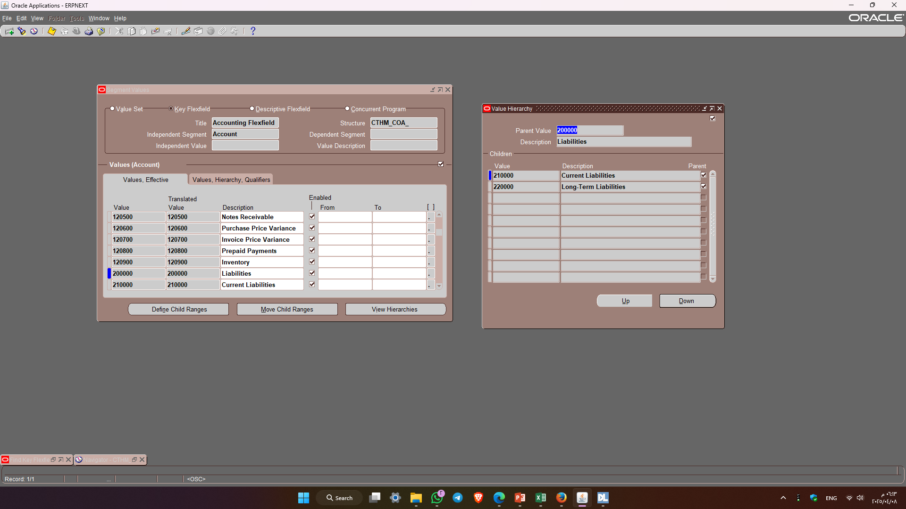
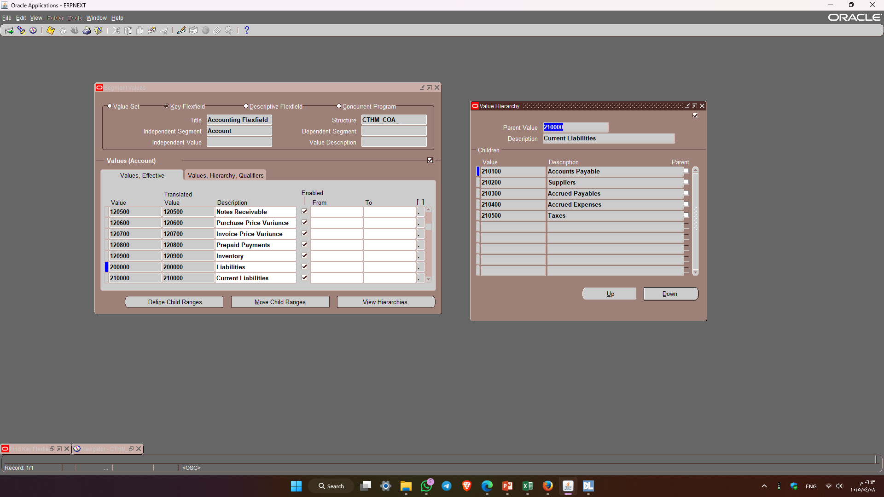
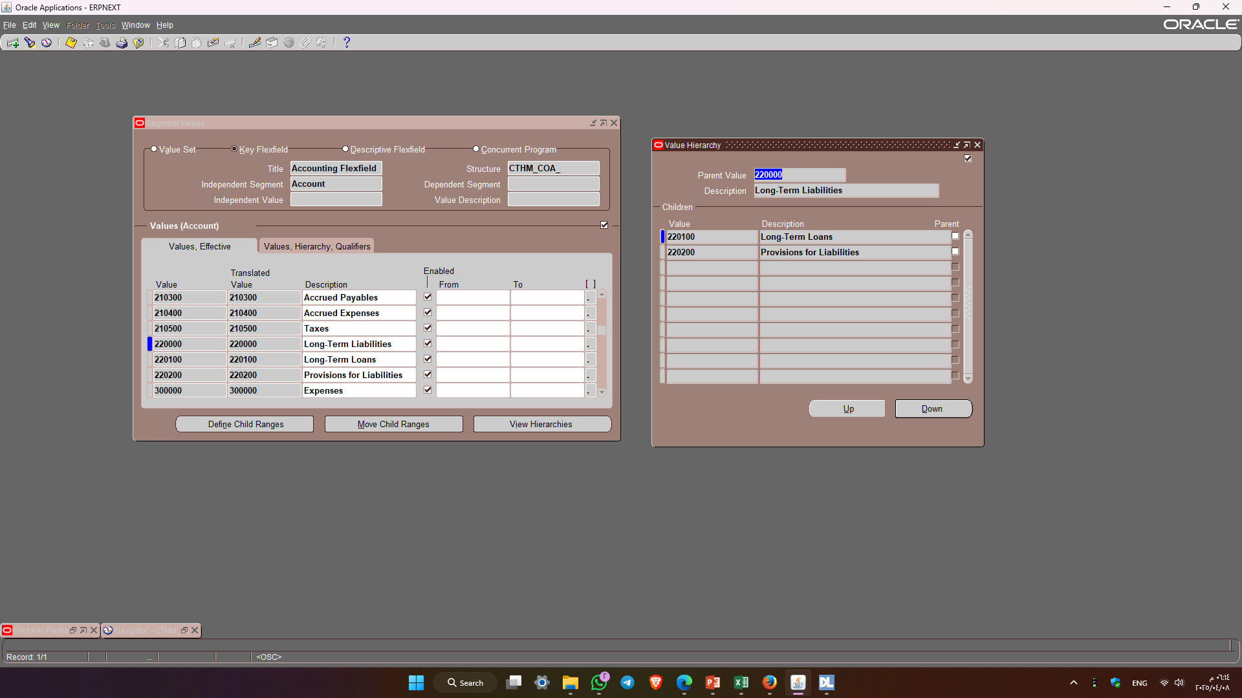

Slide 18
2.Creating Calendar

Slide 19
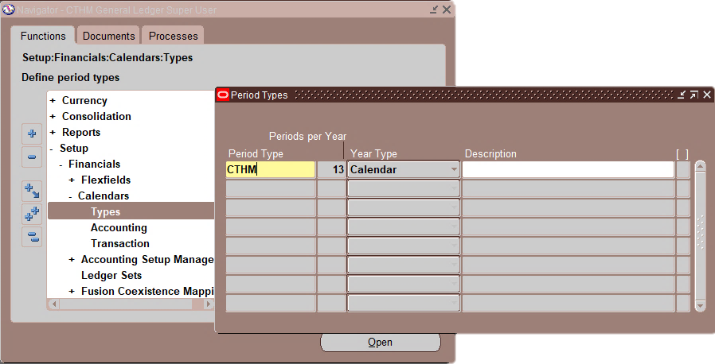
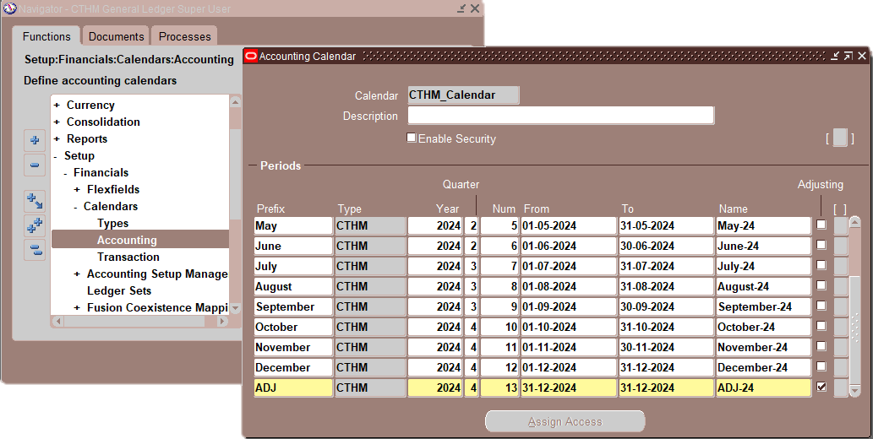
(A) Defining New Period Type:
N: Setup → Financials → Calendars → Types
(B) Creating New Calendar:
N: Setup → Financials → Calendars → Accounting
Select the Adjustment Period

Slide 20
3- Defining Currencies

Slide 21
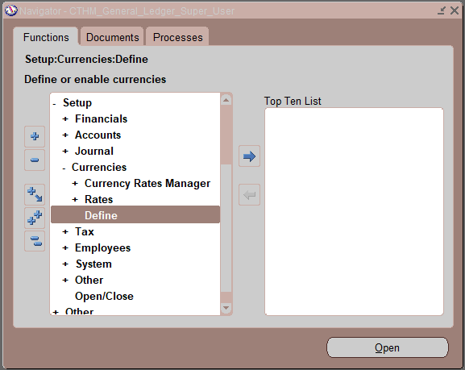
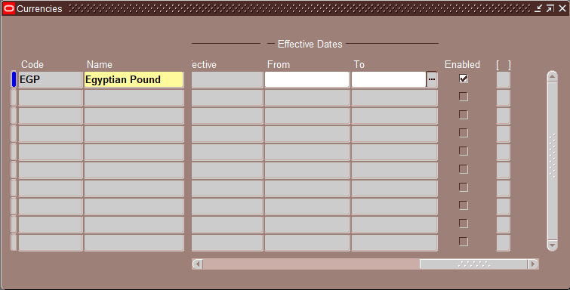
define a new currency
N: - Setup-> Currencies-> Define
Enter Enabled

Slide 22
4- Accounting Setup

Slide 23
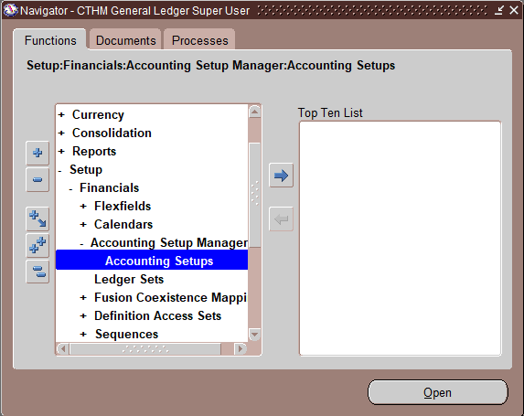
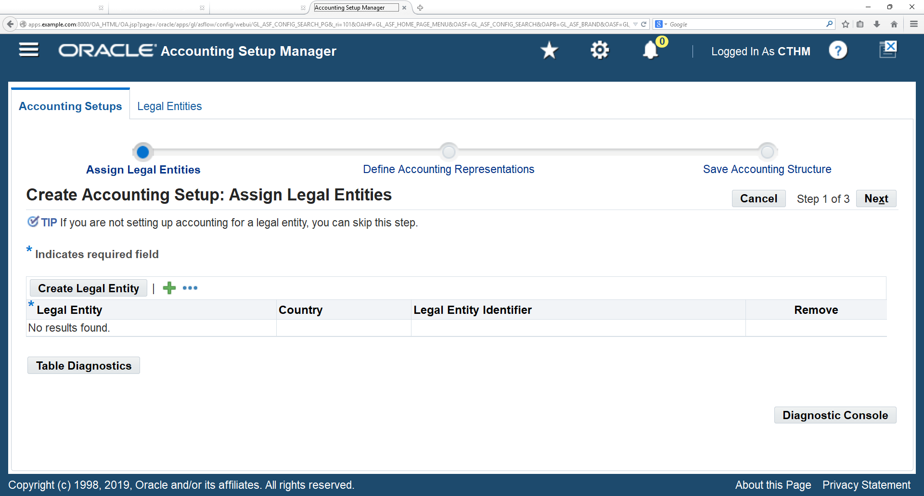
create Legal Entity
N: - Setup → Financials → Accounting Setup Manager → Accounting Setups
Click on “create Legal Entity” button

Slide 24
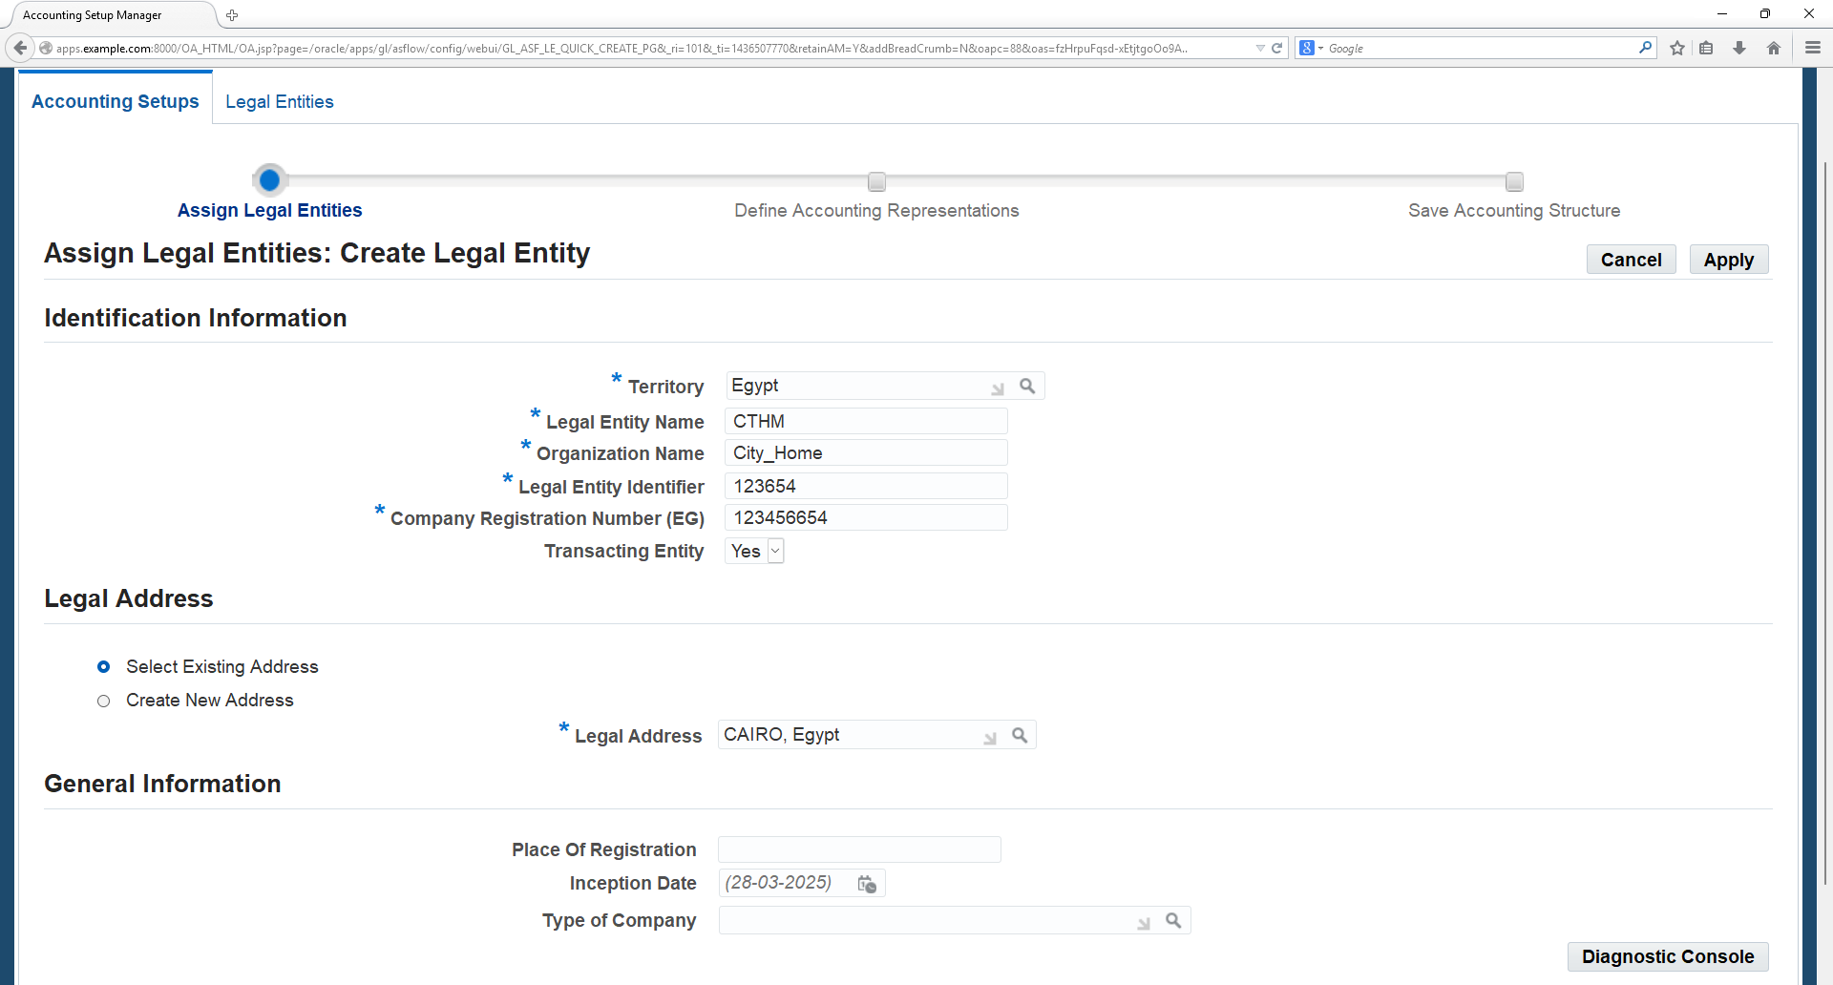
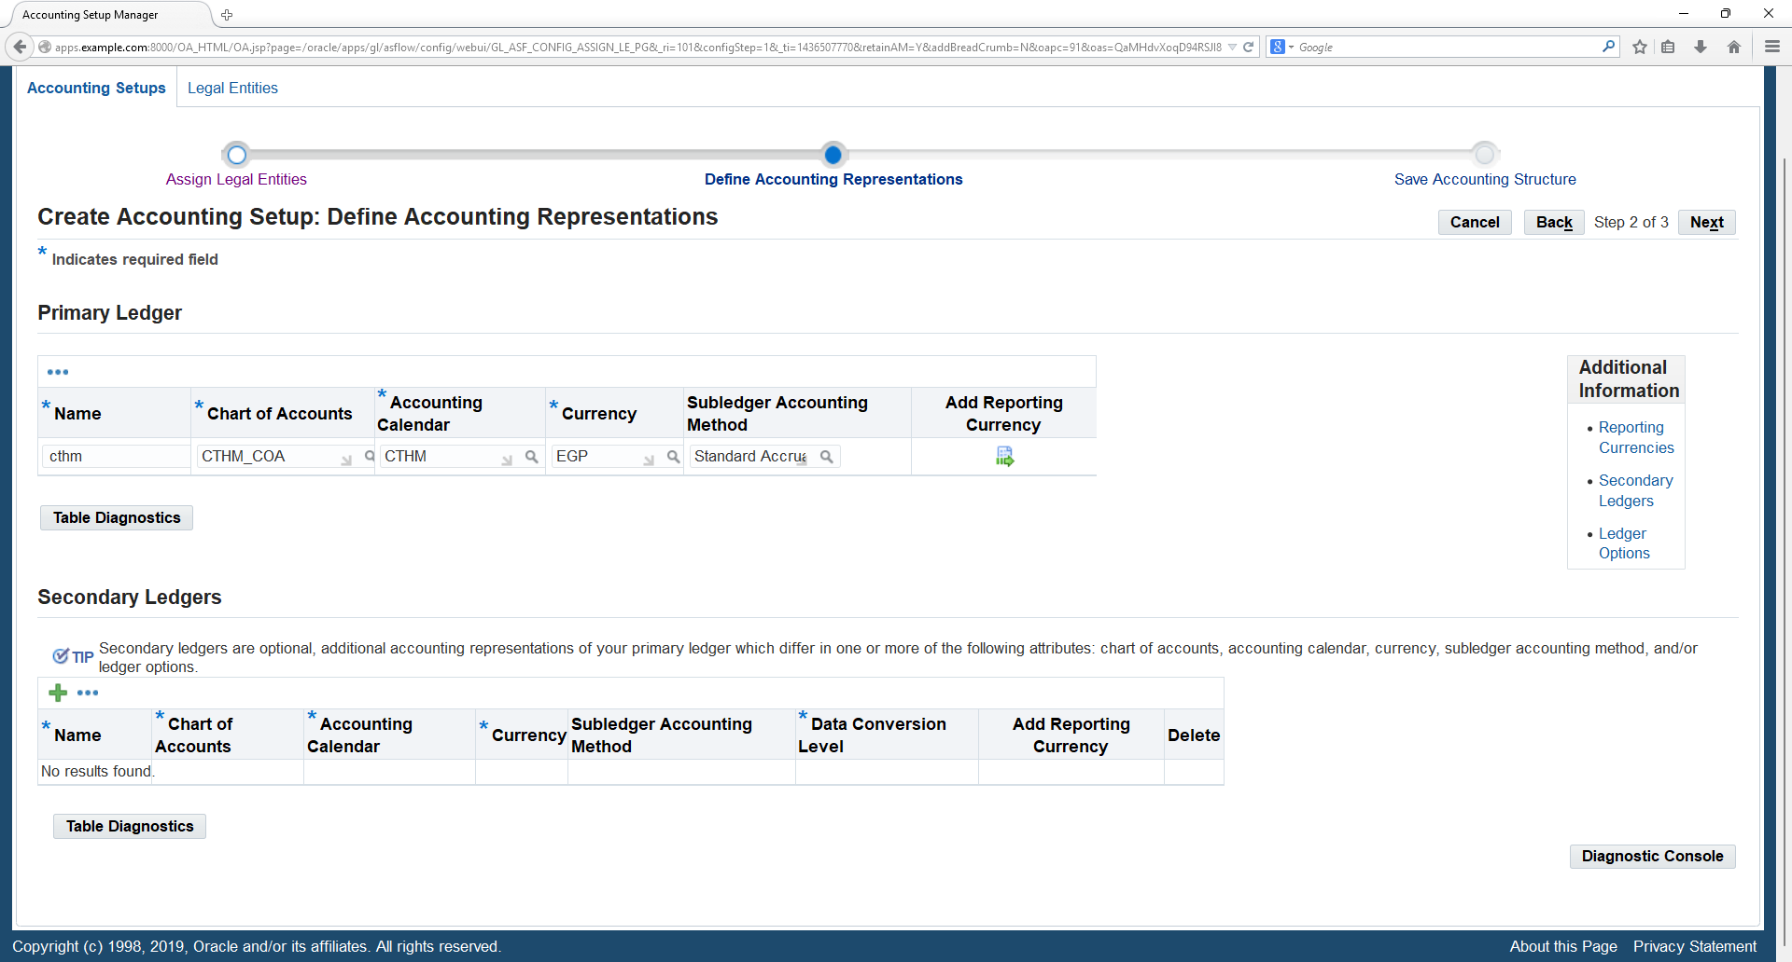
Enter the Territory as Egypt then enter the Legal Entity information as seen in above screen.
Enter the address then Click on „Save and Add Details‟ and Apply
Enter the Primary Ledger name as CTHM, Chart of Accounts as CTHM_COA, Accounting Calendar as CTHM_, Currency as EGP, and Sub ledger Accounting Method as Standard Accrual, then Click on Next button.

Slide 25
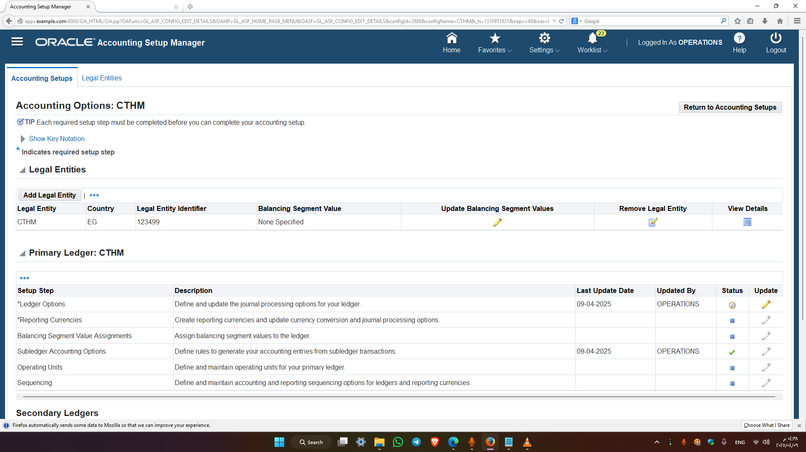
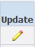
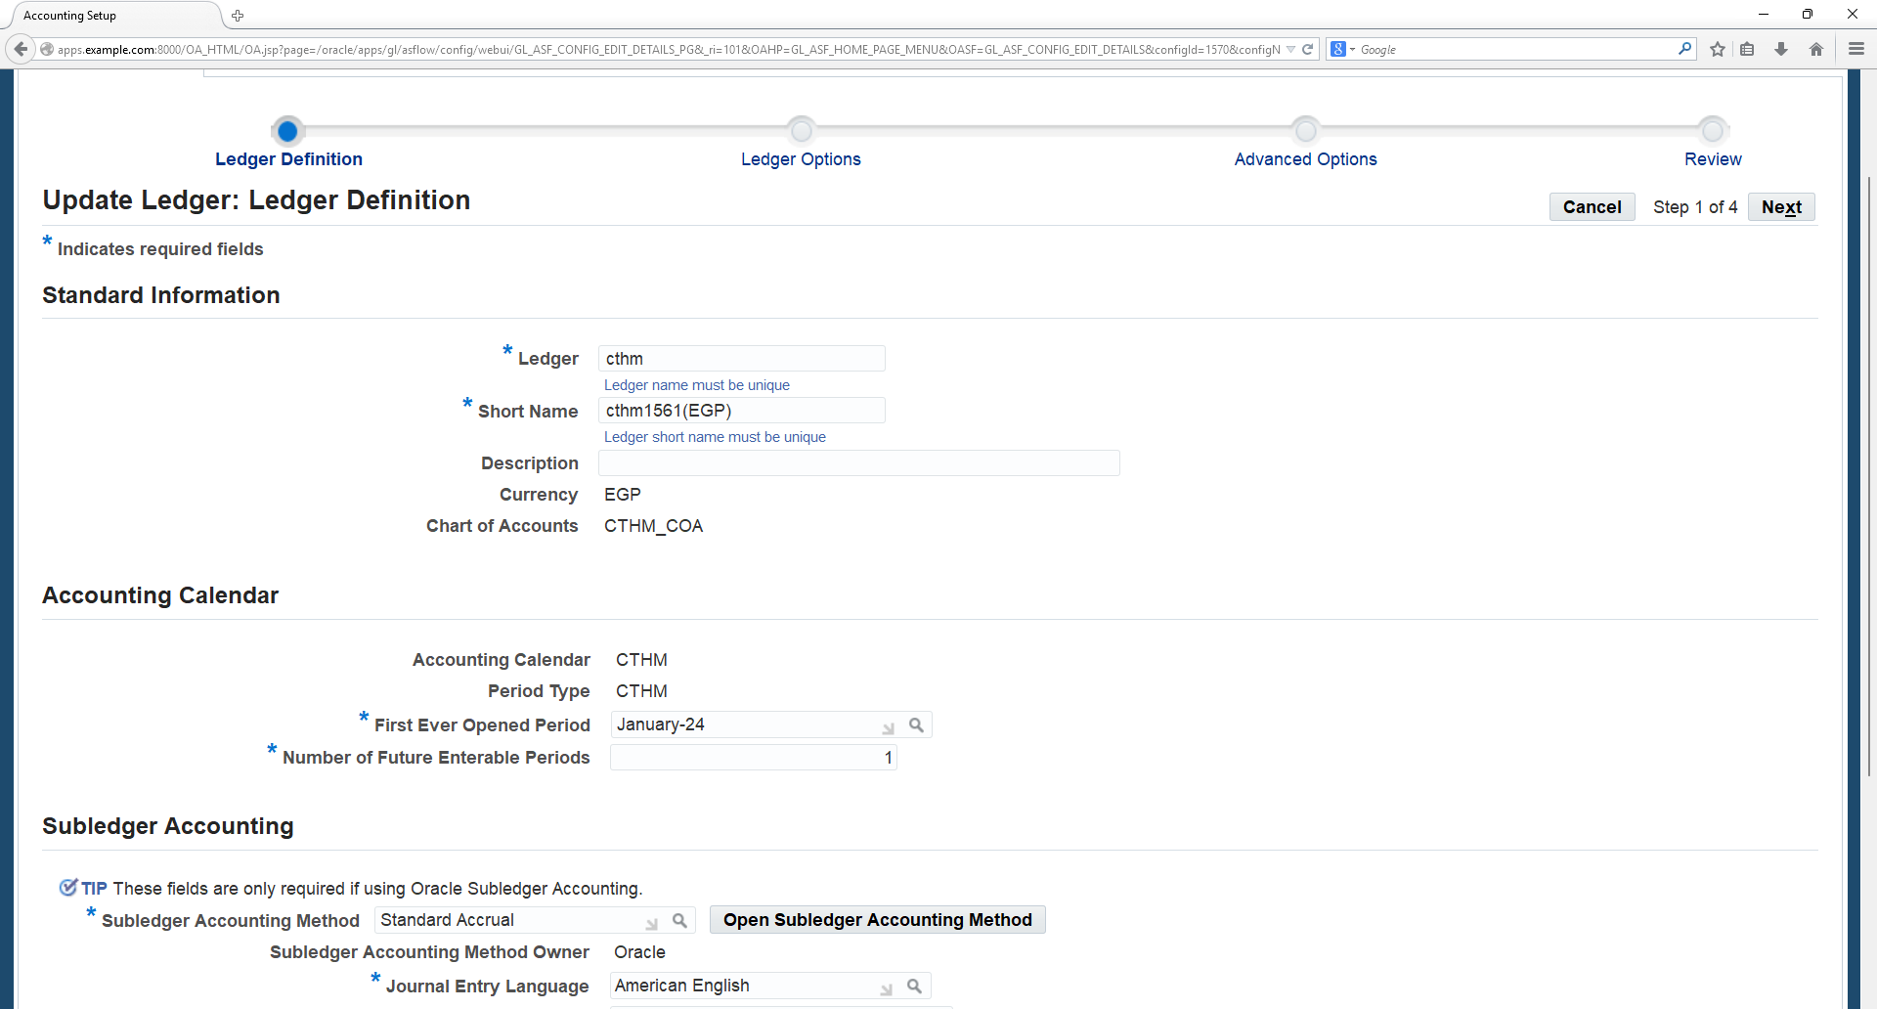
Select the Setup step as Ledger Options and click on Update icon
Check the Ledger options and enter the First ever opened period and Number of Future enabled periods as 1 and enter the Subledger Accounting Method as Standard Accrual then click on Next button.

Slide 26
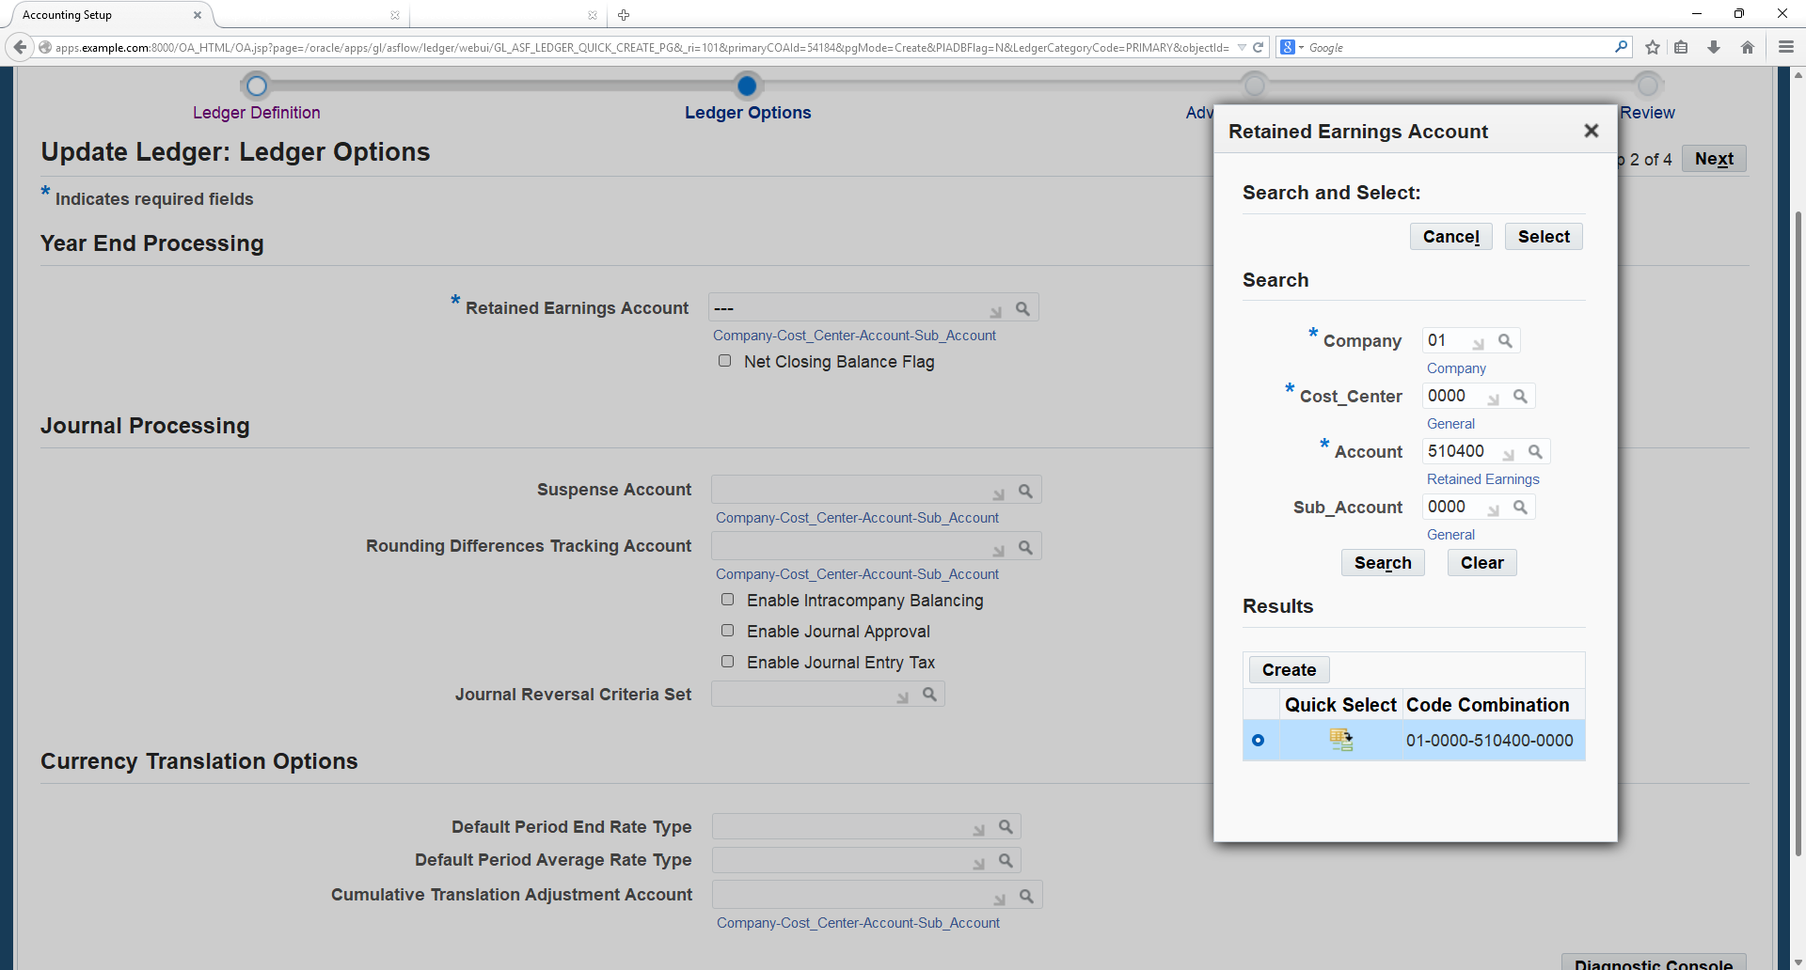
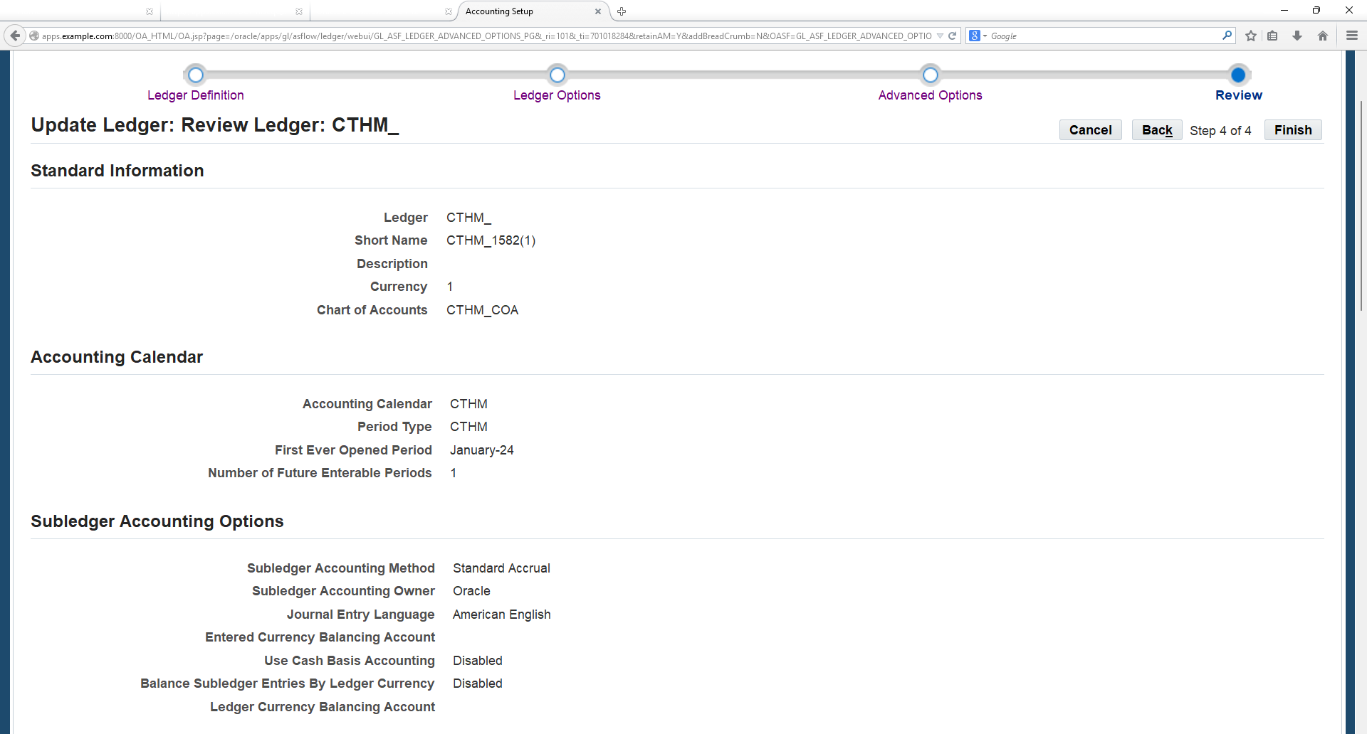
Enter the Retained Account Code combination then click on Next Earning Sutton
Click on Finish button

Slide 27
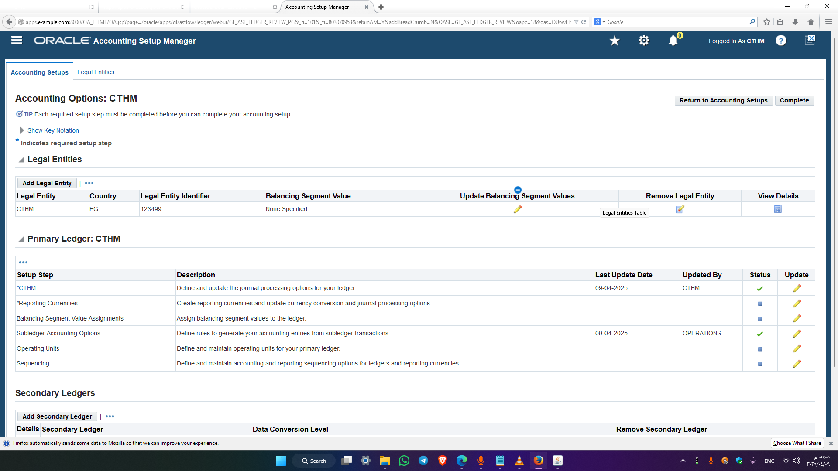
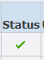
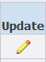
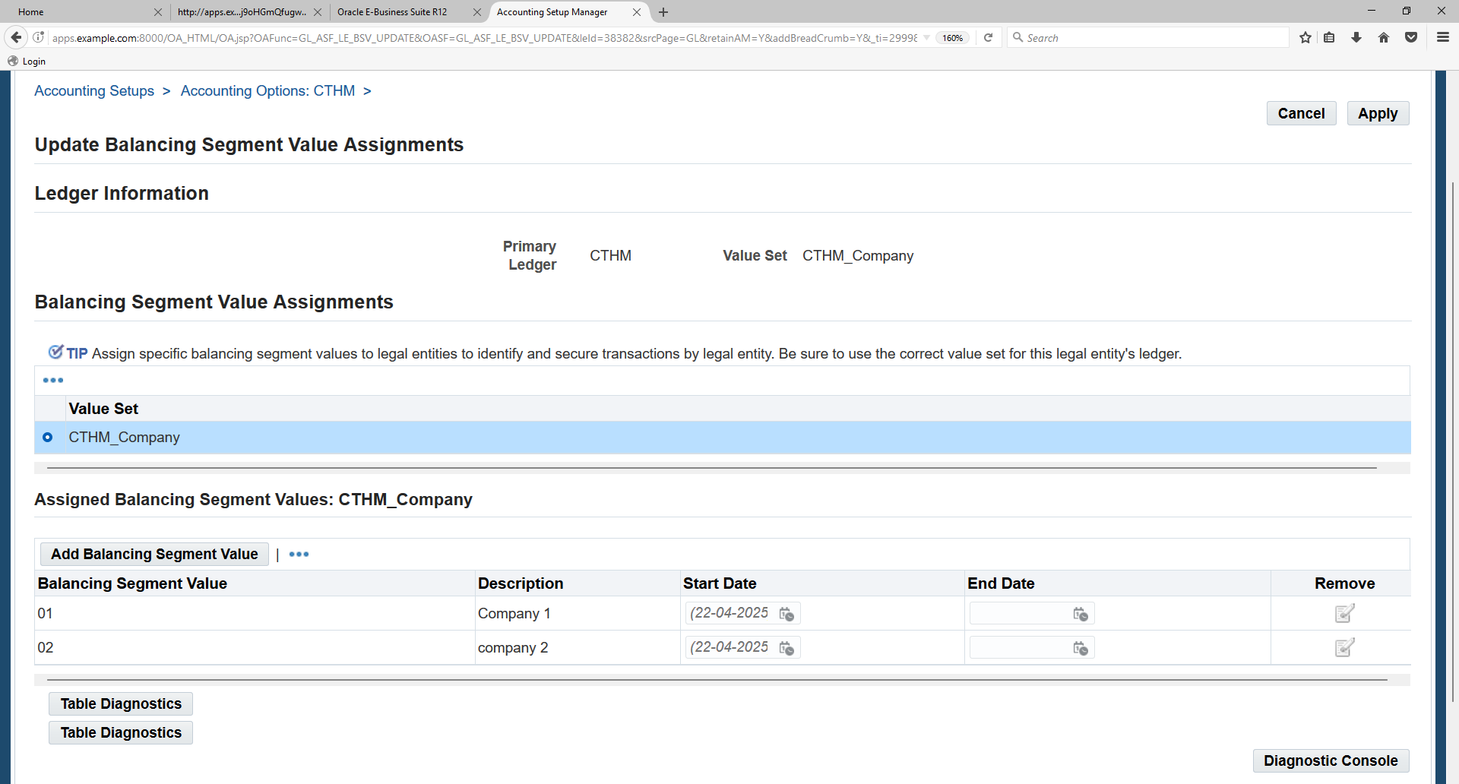
Balancing Segment Value
Check the status of the CTHM Ledger as
Click on Balancing Segment Value Assignments and click on Update icon
Click on Add Balancing Segment Value button and enter the Values then Click on “Complete” button

Slide 28
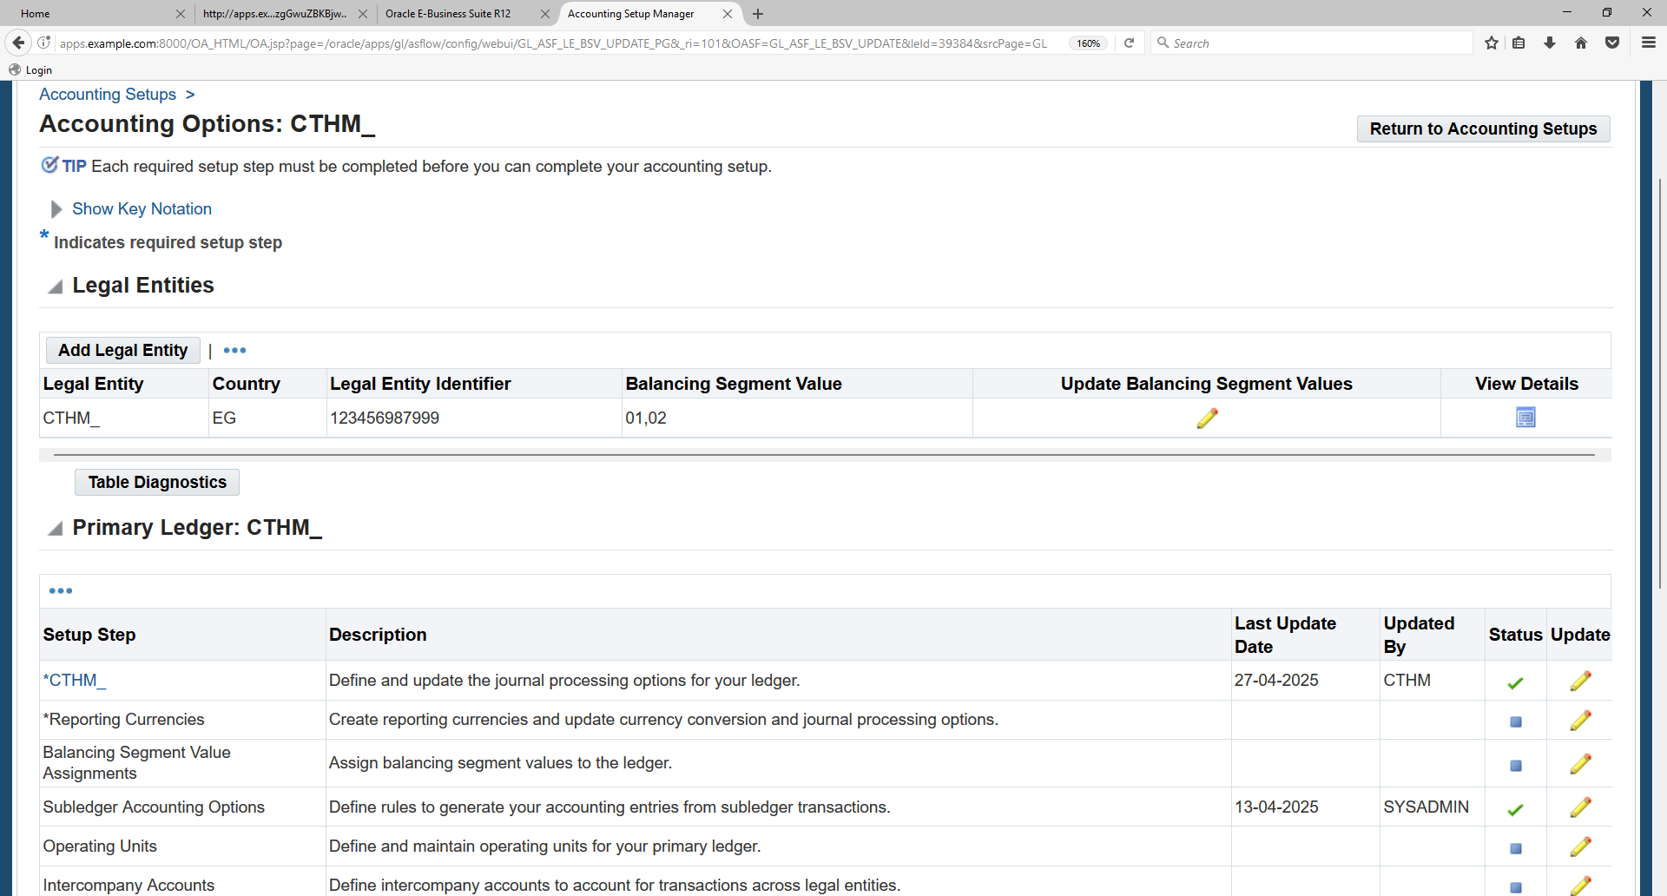
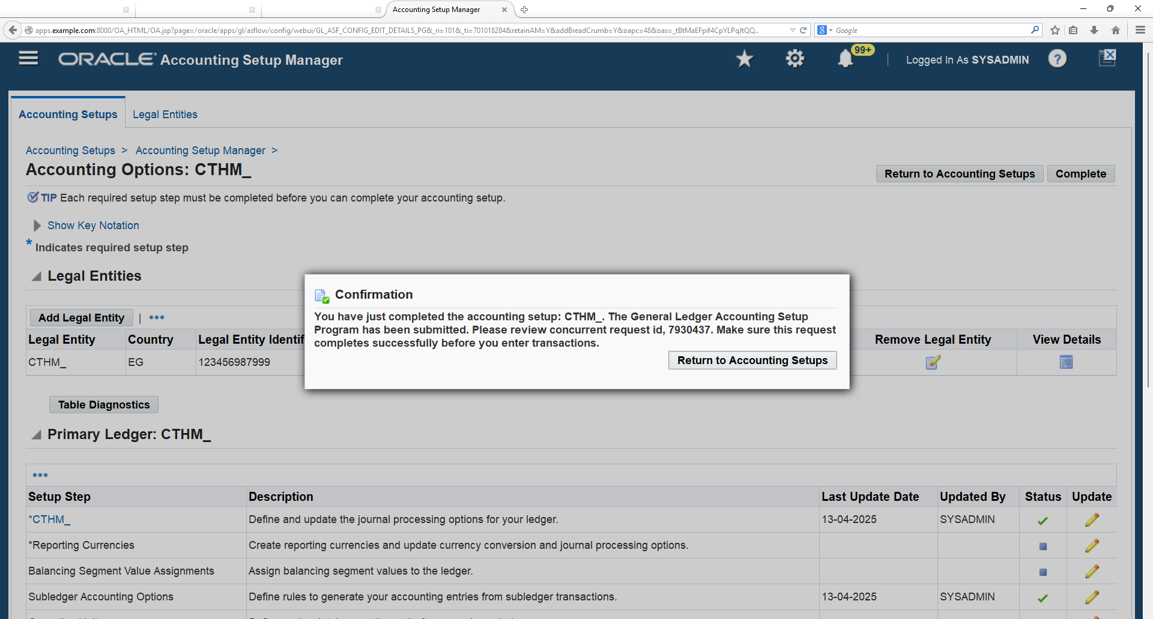
Check all the Setup step status are completed then Click on Complete
Click on “Return to Accounting Setups” button
Finally check the CTHM ledger status as completed

Slide 29
Ledger Set

Slide 30
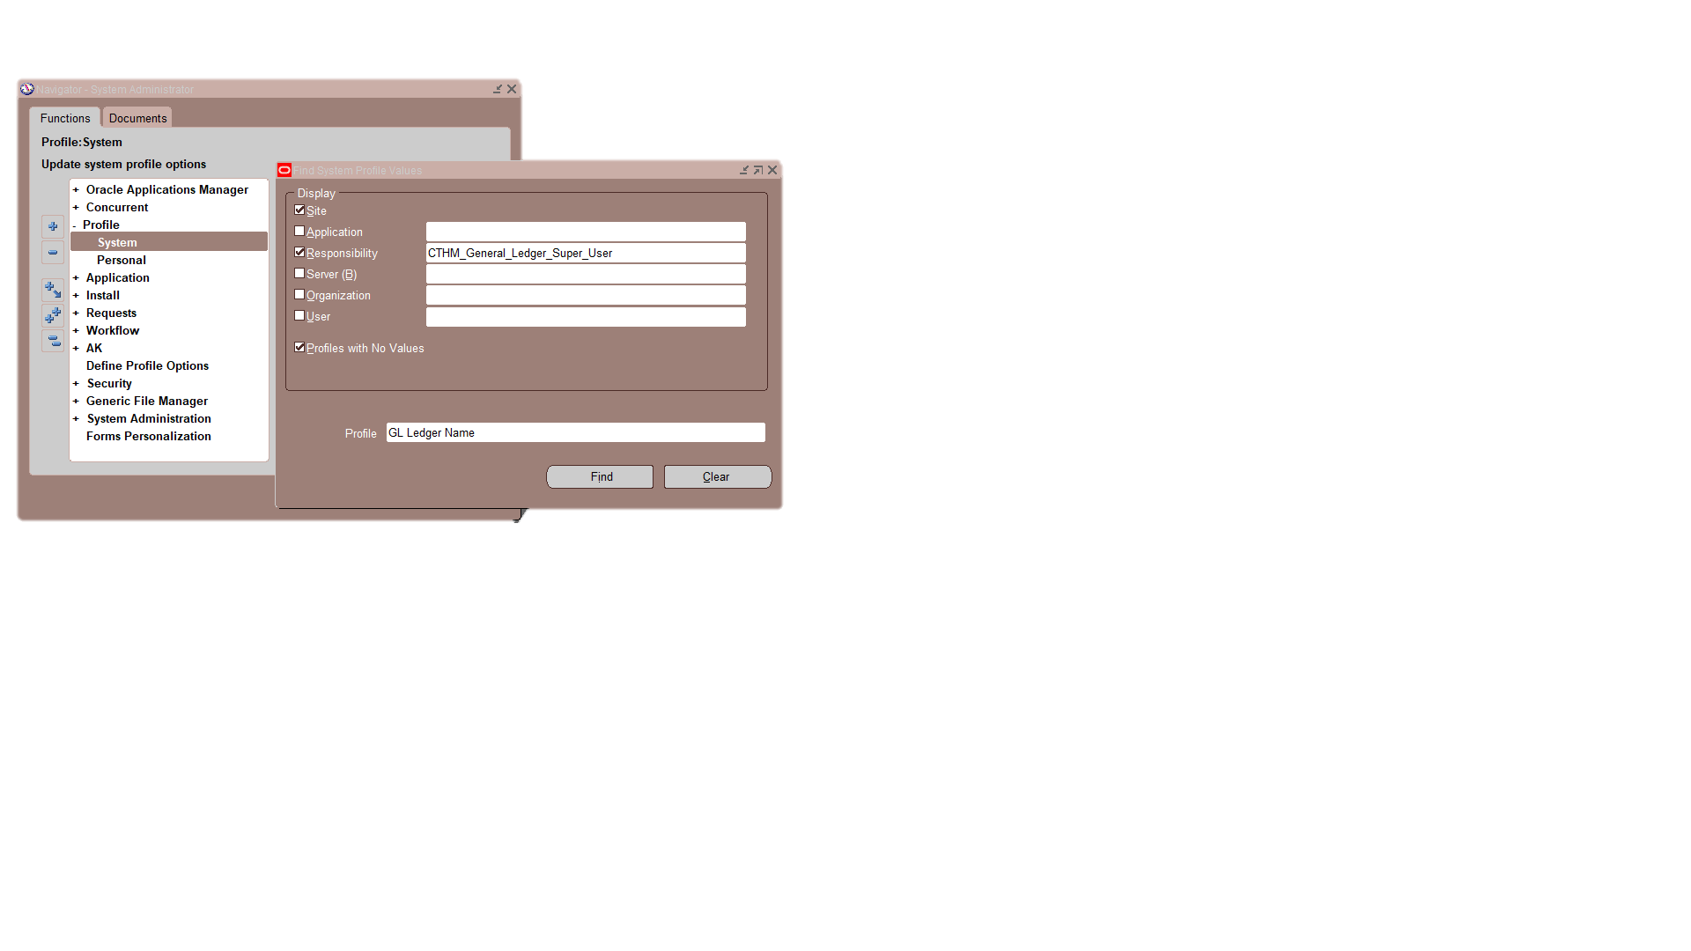
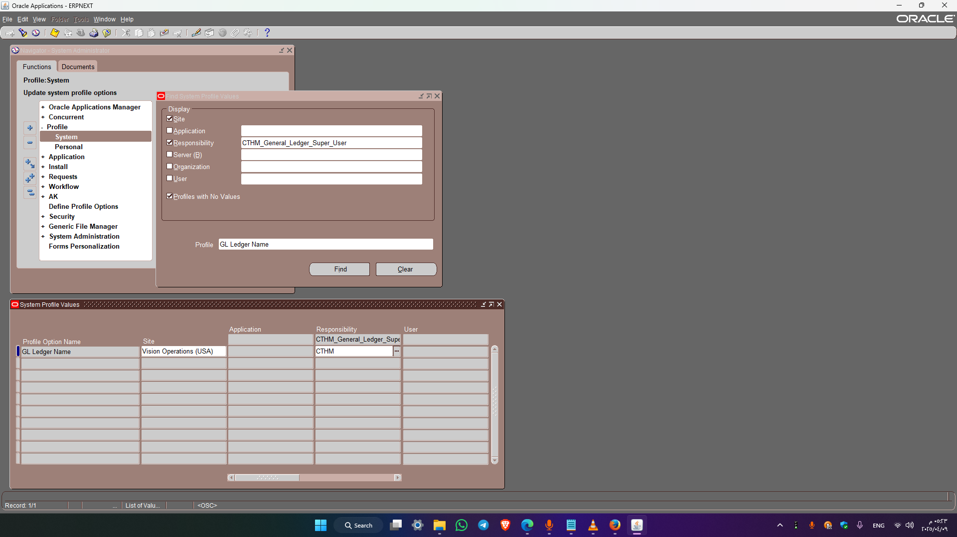
Ledger Set
N: System Administrator → profile → system
Specify the Responsibility (e.g., CTHM_General_Ledger_Super_User) to link the Ledger accordingly.
Enter Profile name as %GL%Ledger%Name%
Enter the Ledger Set name as CTHM that needs to be linked to the Responsibility

Slide 31
Open Periods

Slide 32
Accounting Period
🔓 Open
🔒 Closed
🧱 Permanently Closed
Journal entry and posting are allowed.
The period is fully available for accounting transactions
No journal entry or posting allowed.
Only reporting and inquiry are permitted; the period can be reopened if needed
No journal entry or posting allowed.
This status cannot be changed; only reporting and inquiry are allowed
⛔ Never Opened
⏳Future-Entry
No journal entry or posting allowed.
Applies to periods before the first ever opened or those not yet defined as future-entry
Journal entry is allowed, but posting is not.
The period is within the future-enterable range; must be officially opened to post
Notes:
Open and close accounting periods to control journal entry and journal posting, as well as compute period- and year-end actual and budget account balances for reporting.
Accounting periods can have one of the following statuses:
Open: Journal entry and posting allowed.
Closed: Journal entry and posting not allowed until accounting period is reopened. Reporting and inquiry allowed.
Permanently Closed: Journal entry and posting not allowed. You cannot change this period status. Reporting and inquiry allowed.
Never Opened: Journal entry and posting are not allowed. General Ledger assigns this status to any period preceding the first period ever opened in your calendar, or to any period that has been defined, but is not yet future-enterable.
You cannot change this period status.
Future-Entry: Journal entry is allowed, but posting is not. Your period is not yet open, but falls within the range of future-enterable periods you designated in the Set of Books window. You cannot change this period status without using the concurrent process to open the period. You can open new accounting periods, close accounting periods, reopen closed accounting periods, and open an encumbrance year (if you are using encumbrance accounting).

Slide 33
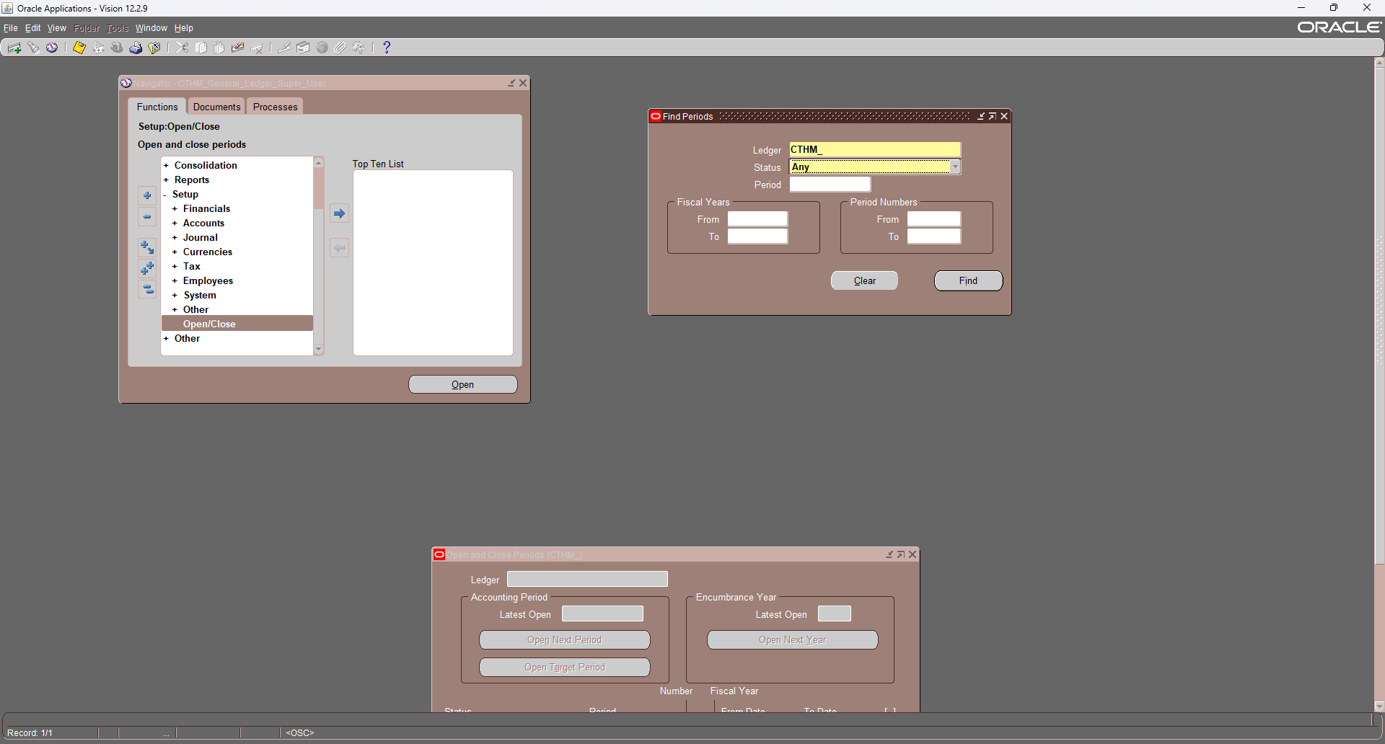


Open Periods
N: Setup → Open/Close
Enter the Ledger name as CTHM and click on Find button
Enter the Ledger name as CTHM and First period as January-24 and click on open button
A concurrent Program Open period is run by system automatically

Slide 34
Entering Journals

Slide 35

Entering Journals
N: Journals → Enter
Click on new batch or new journal
You can use this screen for reference when working with journals in the future.

Slide 36


Enter the batch name and Select the period
Click bouton journal
Enter the Journal name & select the effective date on which entry is created & Select Currency
Enter the line number, select the account, then input the amount based on whether it's debit or credit
Click save → CTRL + S

Slide 37



Click the post button
Go to the Reports screen to verify that the batch has been posted successfully
Verify the successful posting of the journal entries from the Journal Entry screen

Slide 38
Reverse Journal

Slide 39




Go to the journal entry you need to reverse
Click Reverse
Select the period in which you want to reverse.
Choose the Switch Dr/Cr OR Change Sign
Verify that the report has completed successfully

Slide 40



Search for a journal entry that starts with the Reversed
Click on Review Journal
Click post

Slide 41
Recurring Journal

Slide 42


A: Creating Recurring Journal Formula Batches
N: - Journals → Define → Recurring
Enter Batch Name, Select ledger CTHM.
Enter journal name, Select Currency and Category
Click on Lines

Slide 43


B: Creating Recurring Journal Entries
Enter line number & Select Account number
Enter Step Number & amount.
Click Save
Click the 'New' button on the top bar to add a new line.
Repeat the same steps as before
Enter the debit amount as a negative value.
Save & Exit

Slide 44



Click on Generate and Click on Submit button
Select the period with the transaction date
Click Submit.
Go to the journal screen to verify the success of the transaction

Slide 45



Go to the journal screen and search for the source of the “recurring” journal entry
The journal status should be unposted.
Click on 'Review Journal' to verify the journal balance

Slide 46
Intracompany

Slide 47


Slide 48


Update Ledger: Ledger Options
Setup → Financials → Accounting Setup Manager → Accounting Setups
Search for the ledger name CTHM_
Click update accounting options

Slide 49


Go to step 2
Select Enable Intracompany Balancing box
Click Finish.
Go to Setup step Intracompany Balancing Rules & click Update

Slide 50


Source: Other Category: Other
Debit Balancing Segment Value
Credit Account
Credit Balancing Segment Value
Debit Account
Check that the status is complete

Slide 51


Test Intracompany
Enter the debit and credit accounts for the intercompany
Post the journal
After posting, return to the journal entry to verify its status

Slide 52
Budgeting

Slide 53


Update Ledger: Ledger Options
Select Setup Step CTHM_ , Click update
Go To Step 3
Activate
Enable Budgetary Control
Require Budget Journals
Enter Reserve for Encumbrance Account

Slide 54


A: Define Budget
N: Budget → Define → Budget
Enter Name & Enter the Status of your budget : Open - Current - Frozen
Define the time period for which the budget will be active
"Click 'Save' to, then go to the Report screen to verify that the periods have been opened successfully

Slide 55

B: Defining Budget Organizations
N: Budget → Define → Organizations
Enter Name & Display sequence
Click Ranges
Define the Account Range
Click Budget Control
Absolute 🔒
Advisory 🔓

Slide 56




C: Enter Budget Journals
N: Budget → Enter → Journals
Enter Name Budget & Organizations
Click Budget Rules.
Select the account to assign, then enter the budget amount.
Save & Reserve Funds
Search for the journal by Category

Slide 57


Post the journal
click 'Post' button
Or
N: journal → Post

Slide 58


Enter the journal entry
Click 'Check Funds'
Click Post
Verify the posting status from the reports window

Slide 59



Correcting a Journal
Enter the journal entry with an amount that does not exceed the available budget
Click Post

Slide 60
Reports Standard

Slide 61


A: Journals - Day Book
Reports → Request → Financial → Standald
Select Request Name
Enter Parameters
Click Submit

Slide 63

B: Trial Balance
Reports → Request → Financial → Standald
Select Request Name
Enter Parameters
Click Submit

Slide 64


Slide 65
Financial Statement Generator (FSG)

Slide 66

A: define a row set:
N: Report → Define → Row Set
Enter a Name and Description for the row set.
Choose Define Rows

Slide 67


Title
Assets

Slide 68




Fixed Assets
Current Assets

Slide 69



Total Assets
Liabilities

Slide 70




Current Liabilities
Long-Term Liabilities

Slide 71




Equity
Total Liabilities

Slide 72




Net Profit or loss

Slide 73



B: define a row set:
N: Report → Define → Column Sets
Enter a Name and Description for the row set.
Choose Build Column Set

Slide 74


C: Defining Financial Reports
N: Report → Define → Report
Enter a Name, report Title
Enter : Row Set & Column Set
Click Run Report

Slide 75


Slide 76
Thanks

